Slide 1

WE CARE HOME CARE
Customer Satisfaction Is Our Priority
MENTOR:
Mr. Suril Patel
PREPARED BY:
Harshil Sheth
Vrunda Savaliya
Vidhi Kapadia

Slide 2
Project Definition
A web-based solution to order/manage home care services (office/home cleaning, washing of rental house, stair cleaning etc.). The customer area should provide online ordering facility of home care services to end user along with management of his/her profile & orders. The admin area should provide easy way to manage customer, services, feedbacks & orders.
2

Slide 3
Objective
On-demand Home Care Services.
Affordable and flexible
Any time at any place.
3

Slide 4







Tools And Technology
4

Slide 5
Modules
ADMIN
USER
5

Slide 6
WE CARE HOME CARE
Admin
User
Login
Login,Registration
Forget Password
Manage Services
Browse Services
Manage Subservices
Browse Categories
Manage Providers
Add to cart
Place Order
Manage Orders
View Order
Update Profile
Manage Customer
Confirmation Email
View Ratings
Manage Feedback
Give Feedback
6

Slide 7




Request data using Fetch Api
Send request to process Data
When User clicks on Button
Backend
Database
Processing data in database and send data to backend
HOW OUR APPLICATION WORKS ??
FRONTEND
Send Response in JSON format
Processing Data
RESPONSE
Show Response based on Request
Backend
7

Slide 8
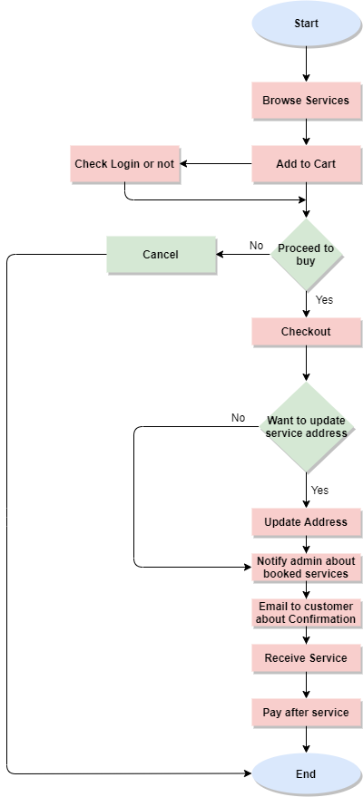
FLOW CHART
8

Slide 9

Implementation-Quick Demo
9

Slide 10
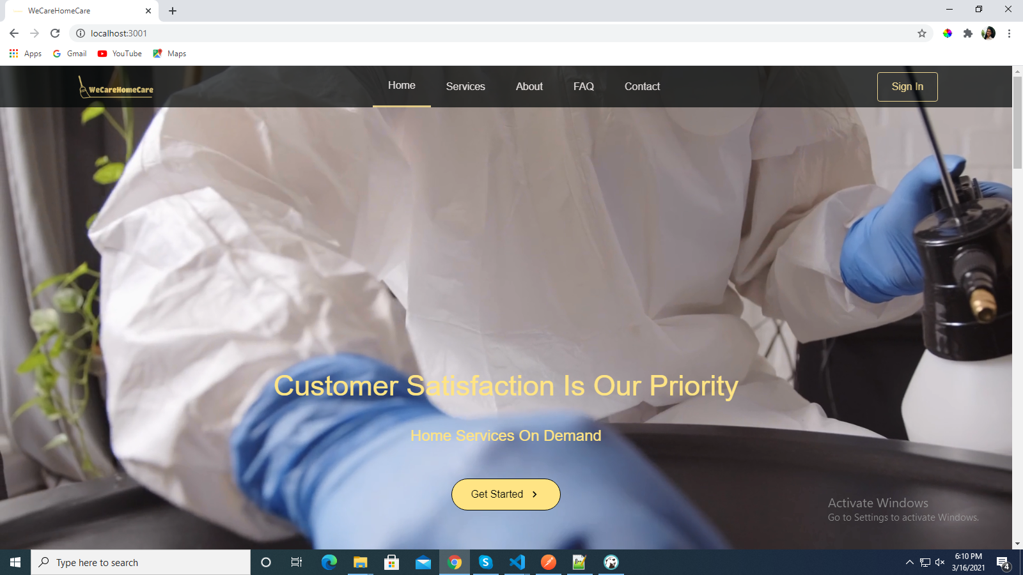
User Dashboard
10

Slide 11
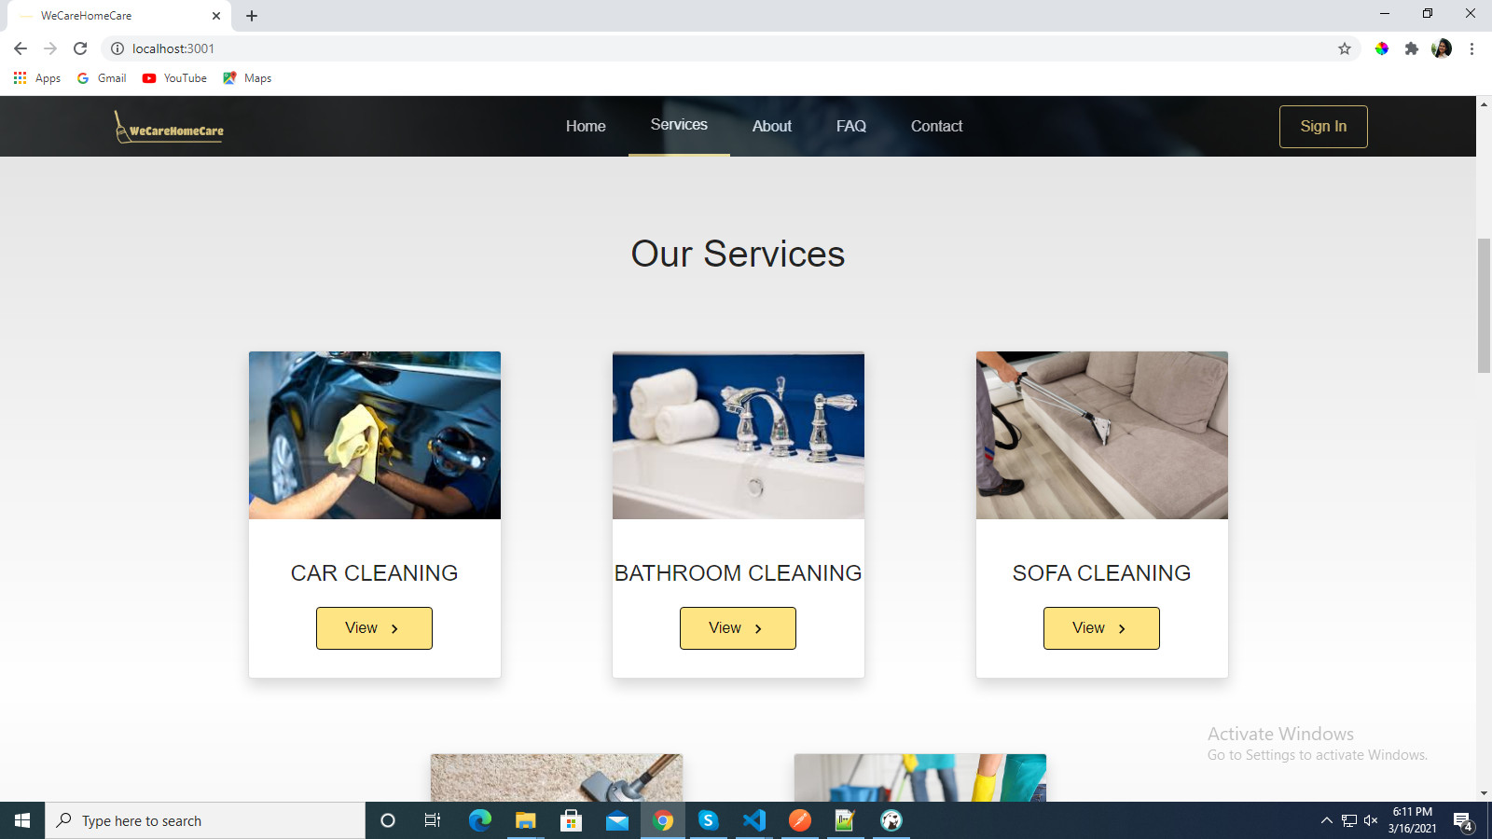
View Services
11

Slide 12
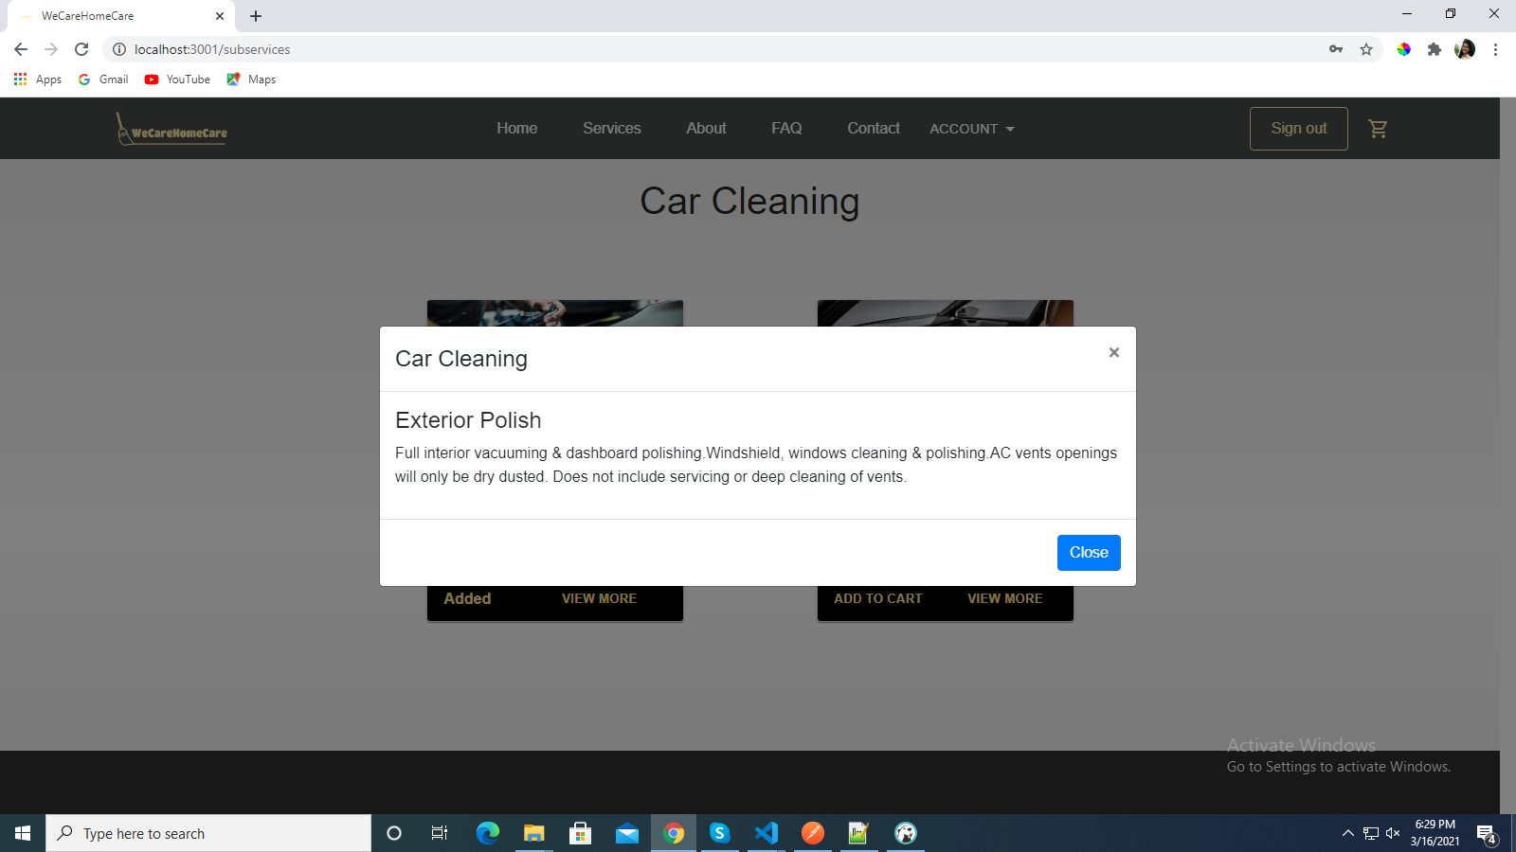
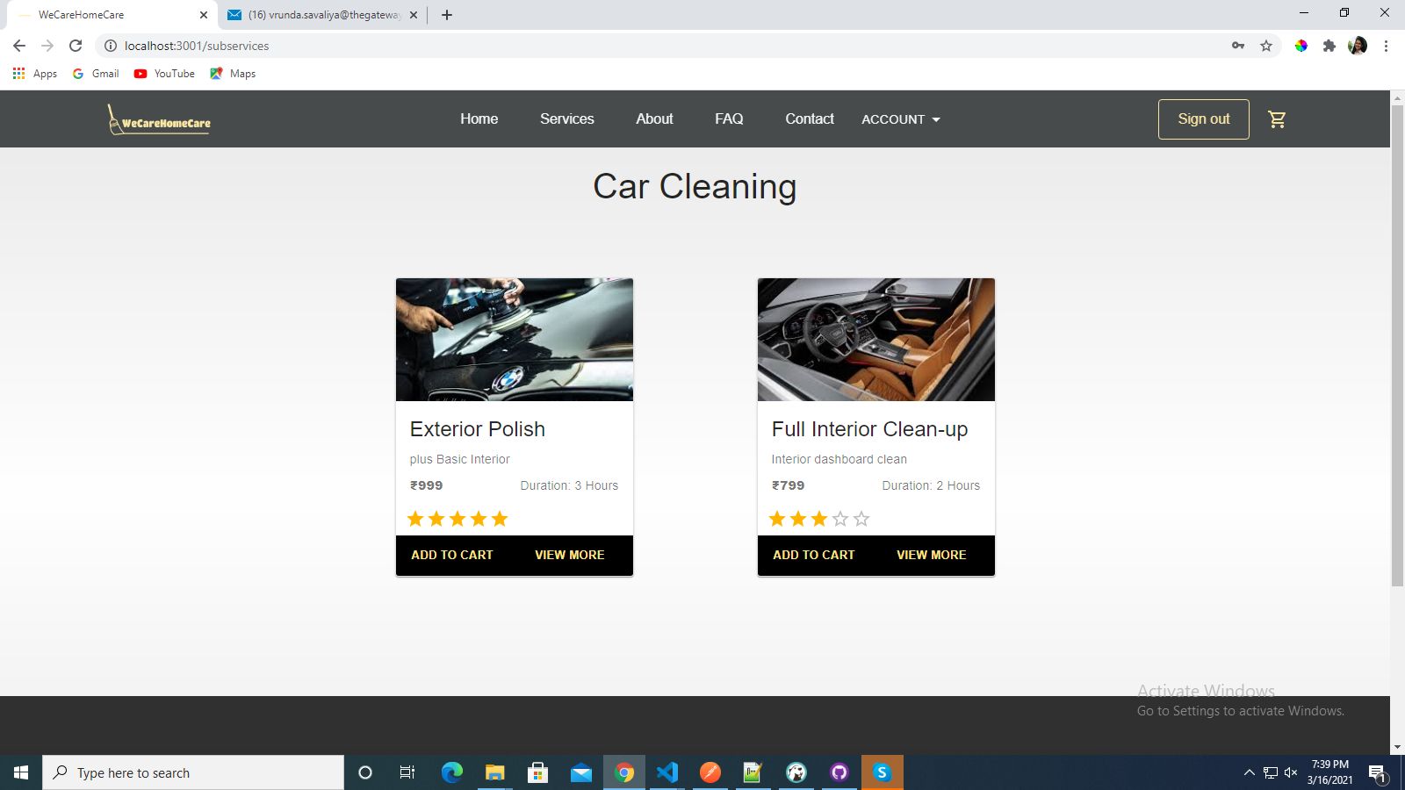
View Service Categories
CLICK ON VIEW MORE
12

Slide 13
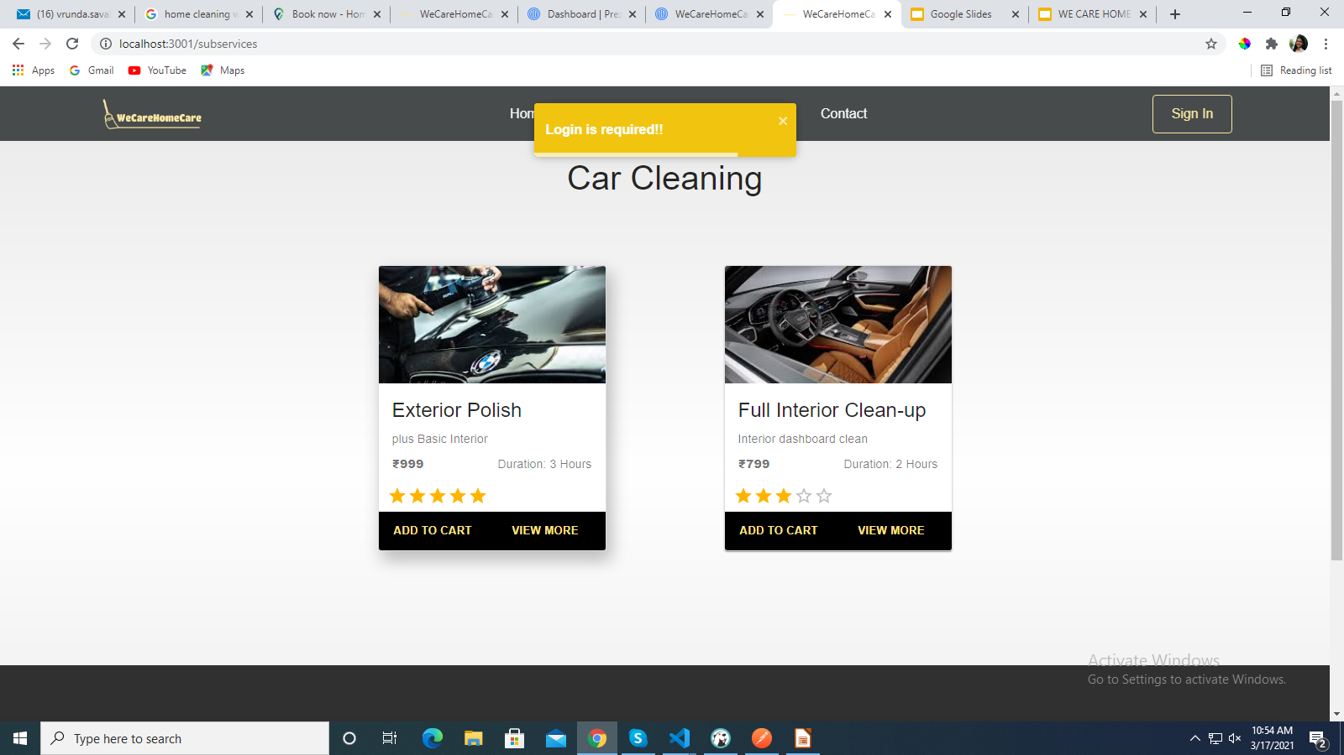
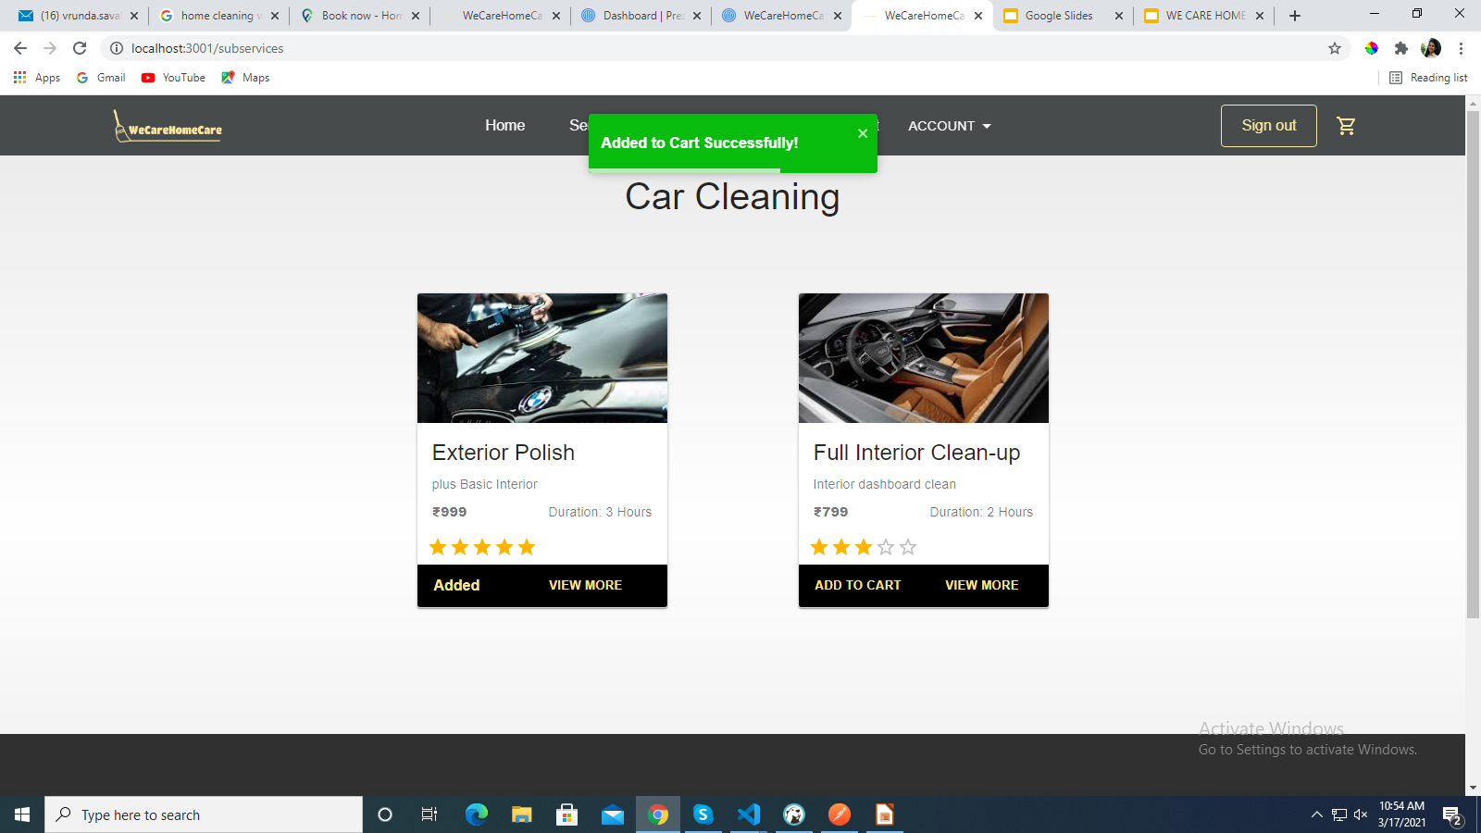
Add To Cart
CLICK ON ADD TO CART
13

Slide 14
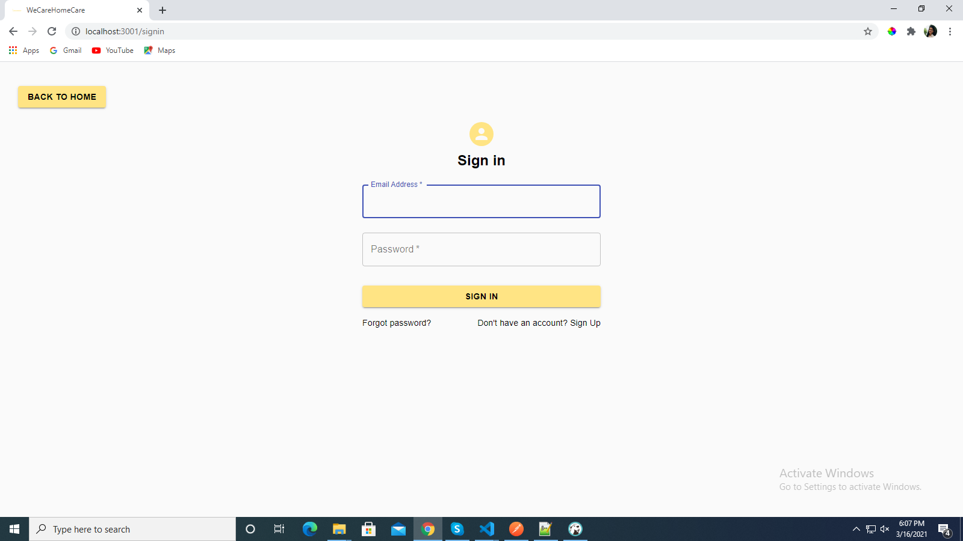
Sign In
14

Slide 15
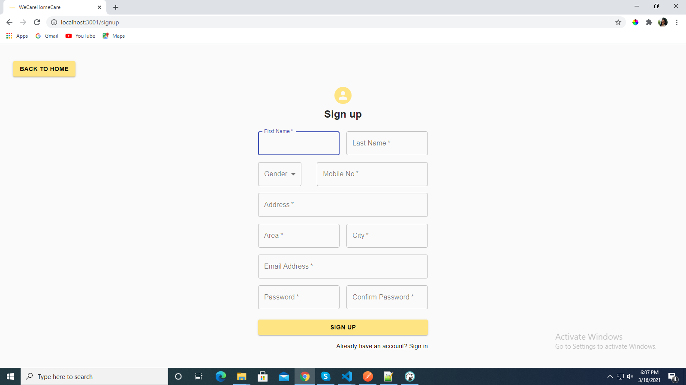
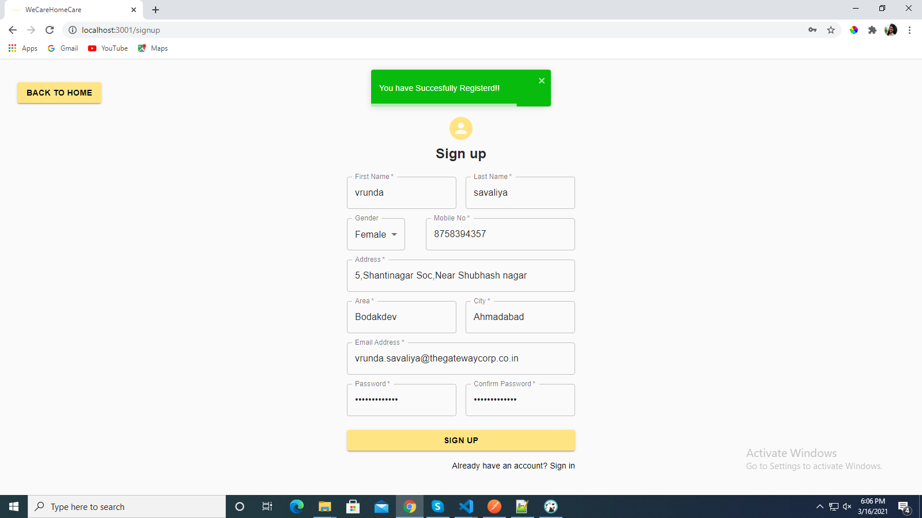
Sign Up
15

Slide 16
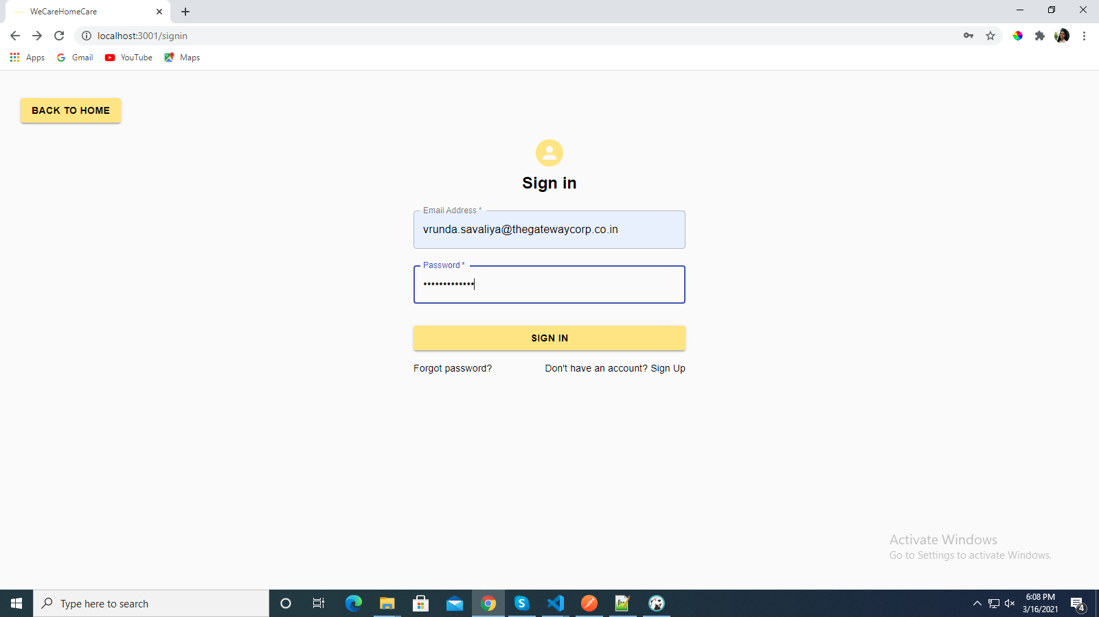
SIGN IN
16

Slide 17
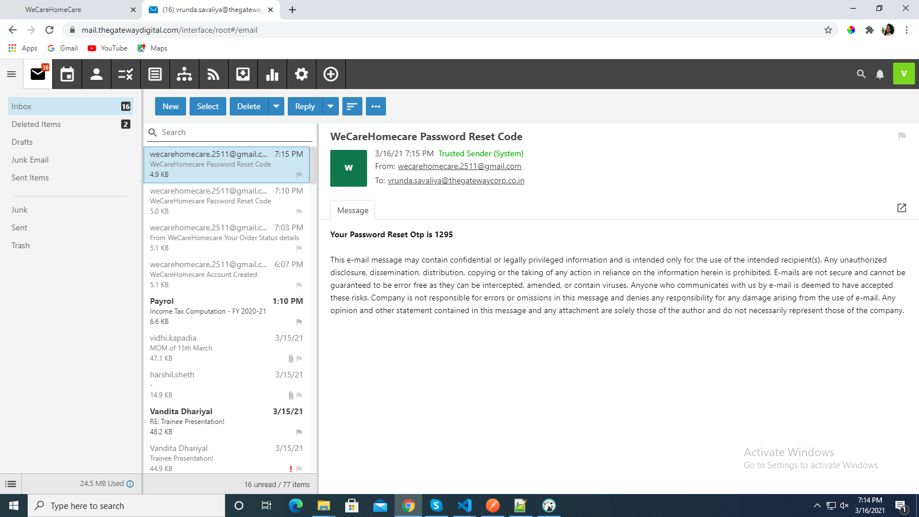
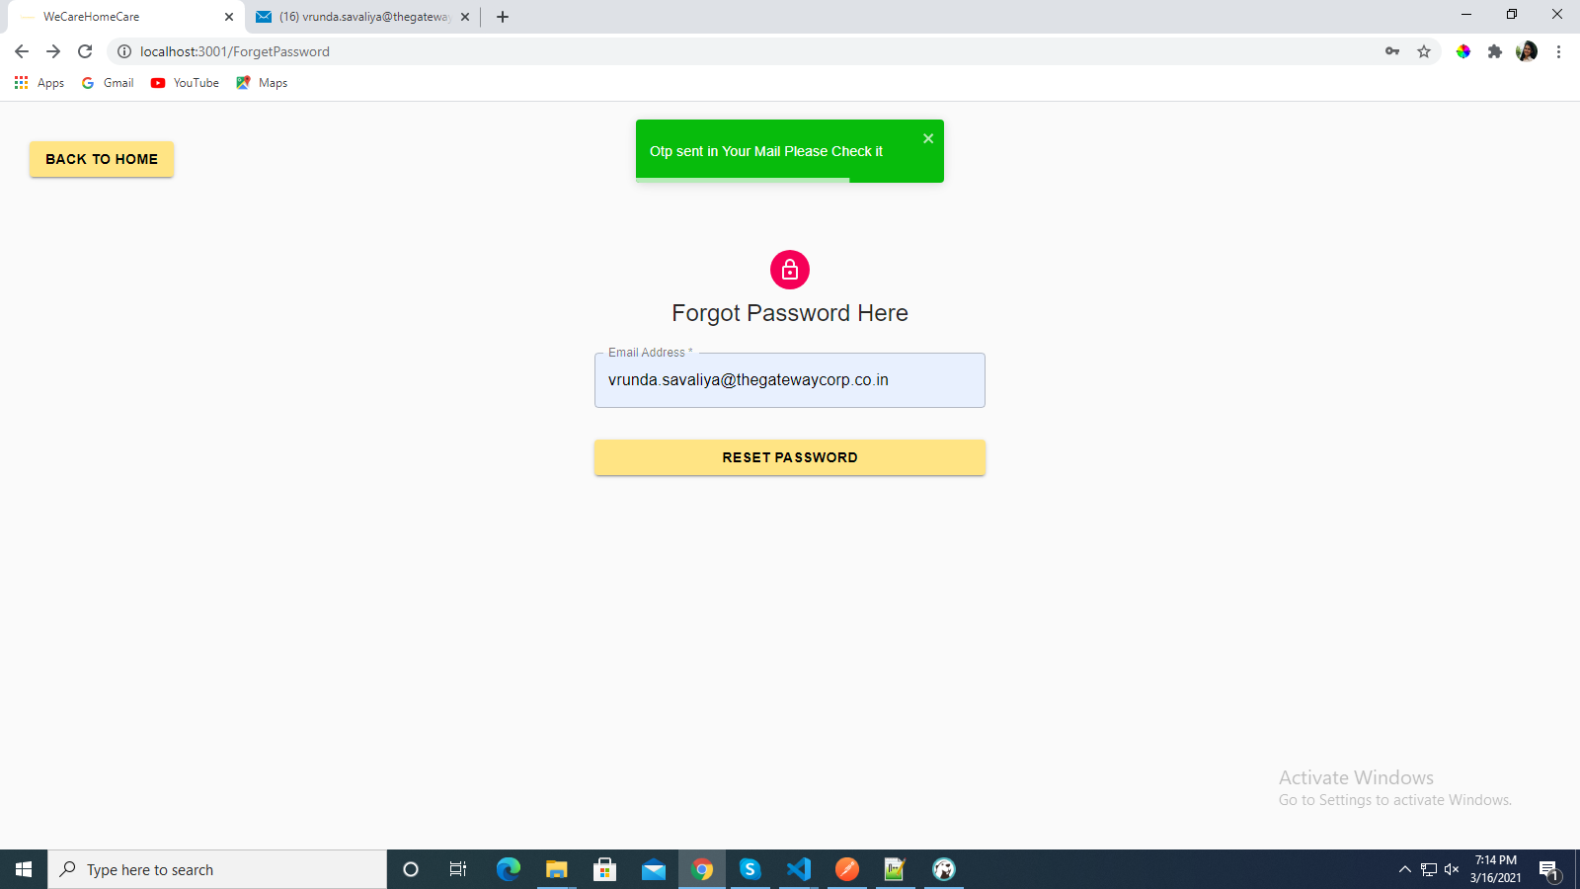
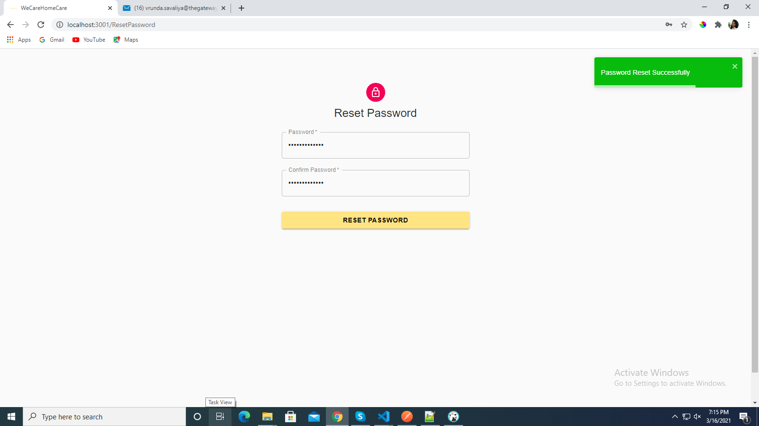
Forget Password
17

Slide 18
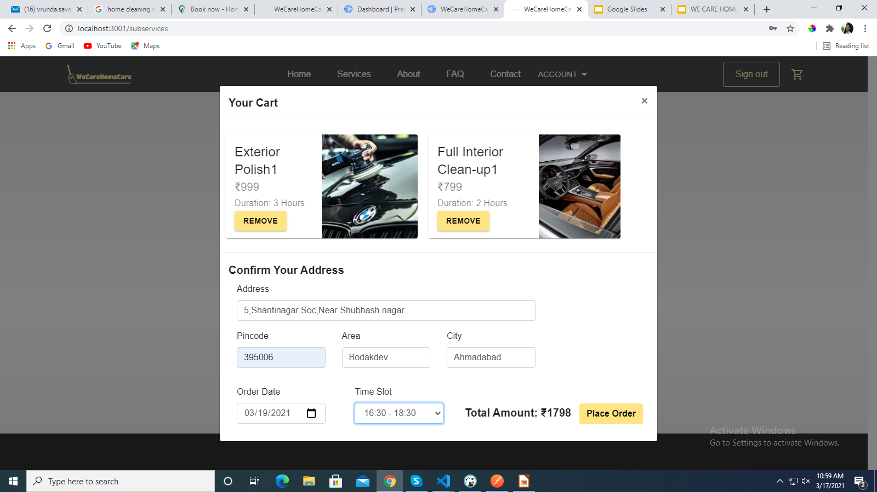
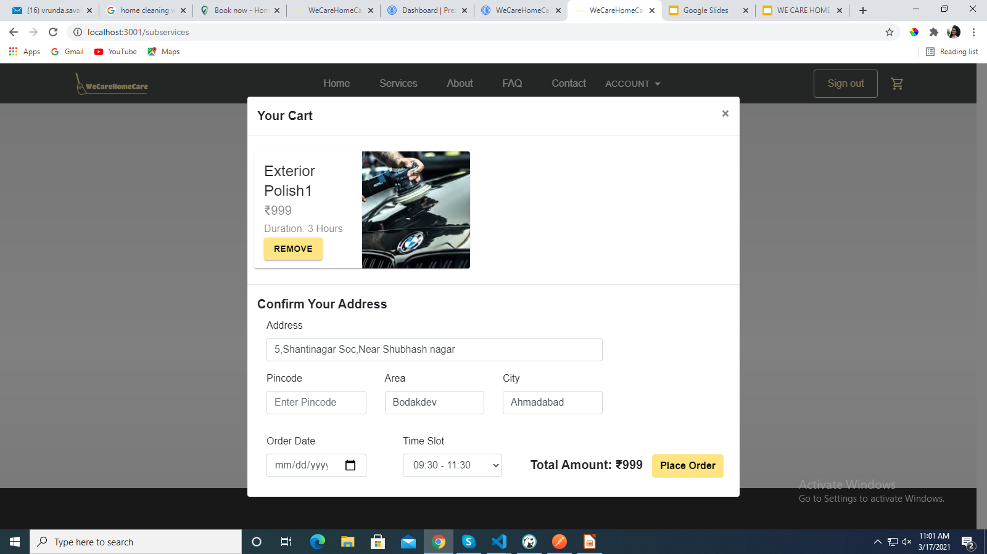
View Cart
18

Slide 19
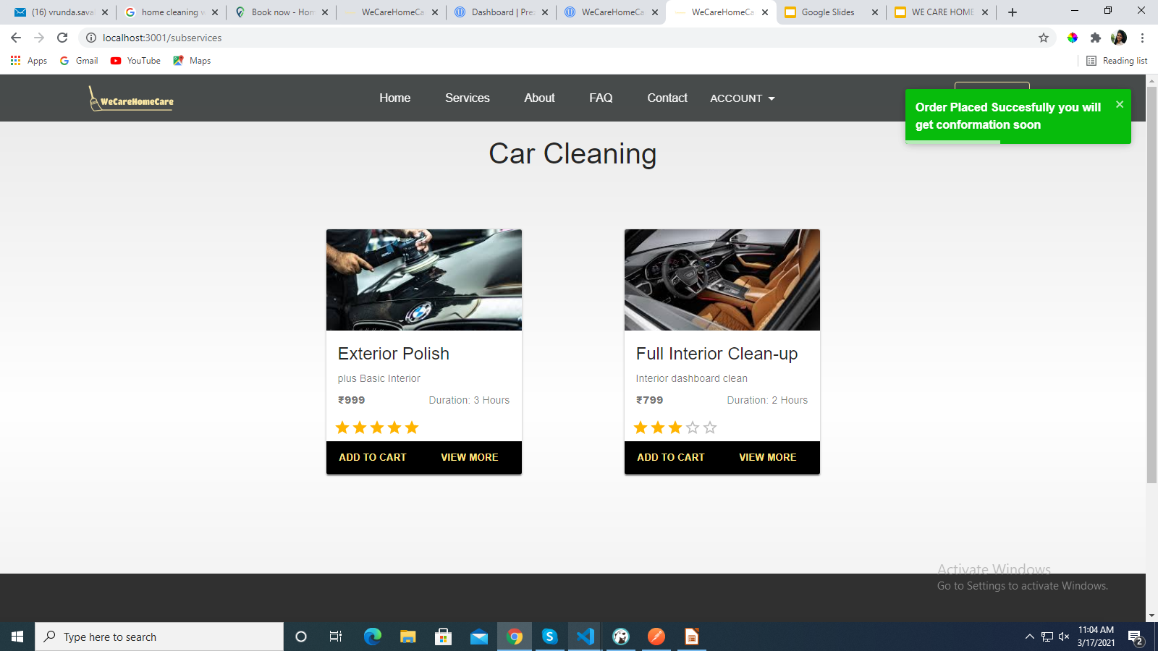
Place Order
19

Slide 20
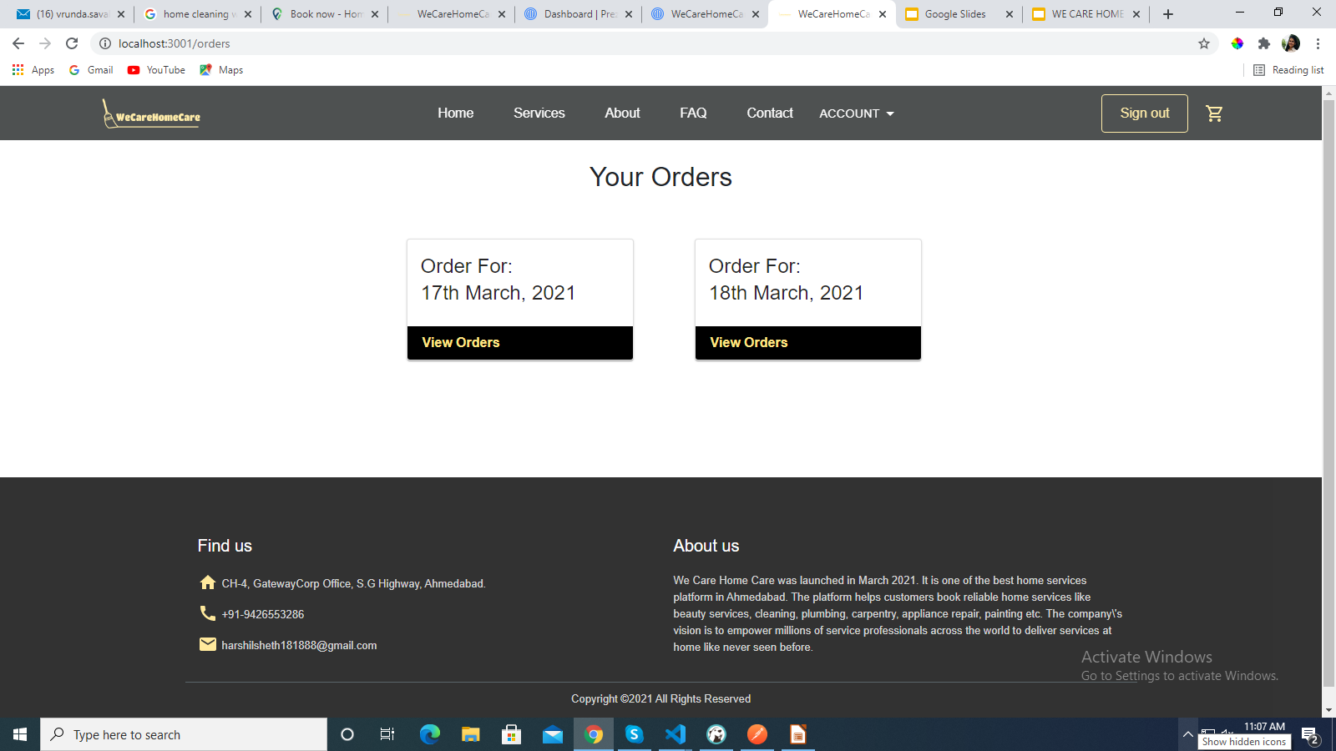
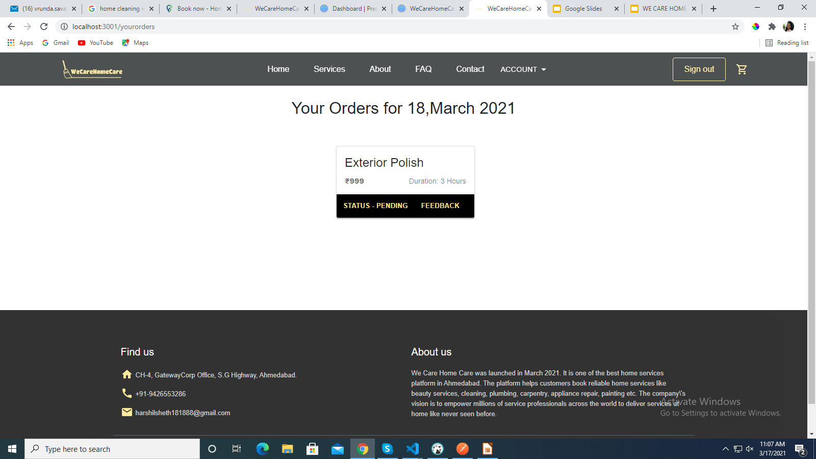
View Order
20

Slide 21
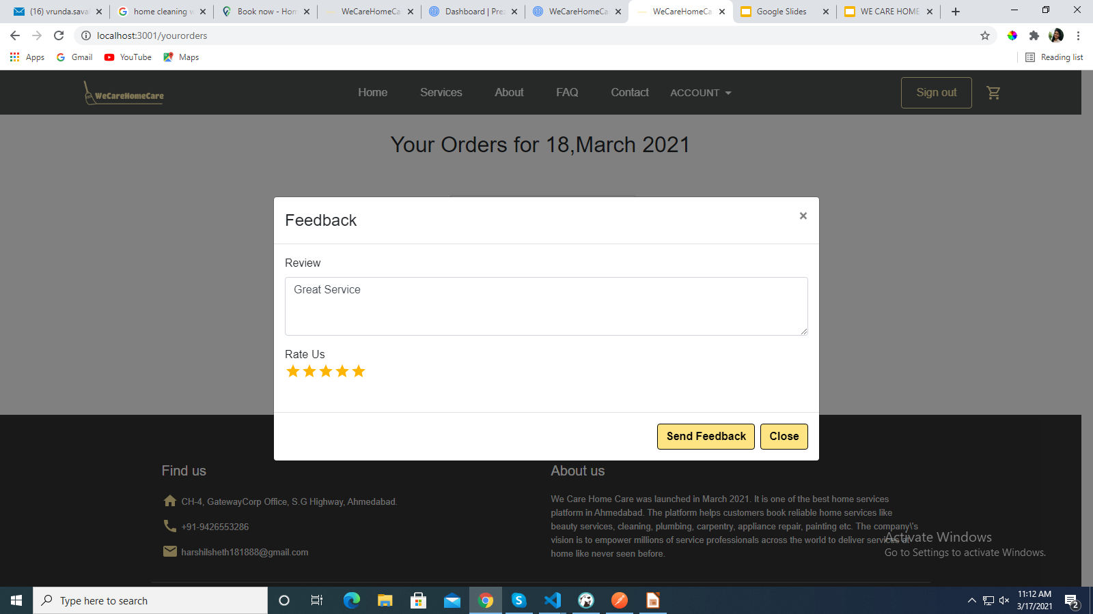
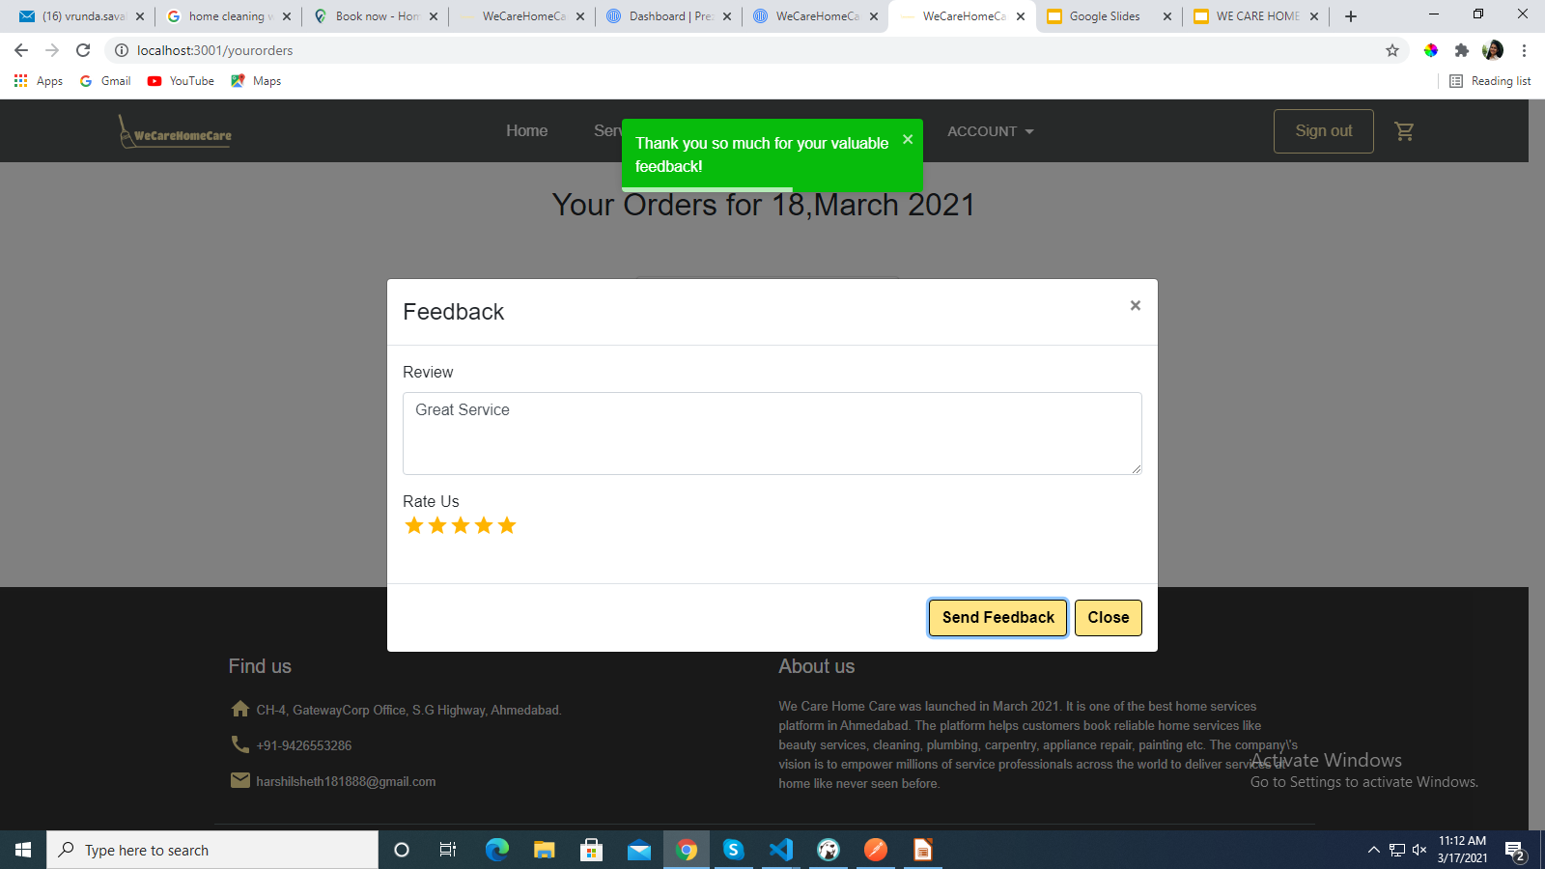
Give Feedback
21

Slide 22
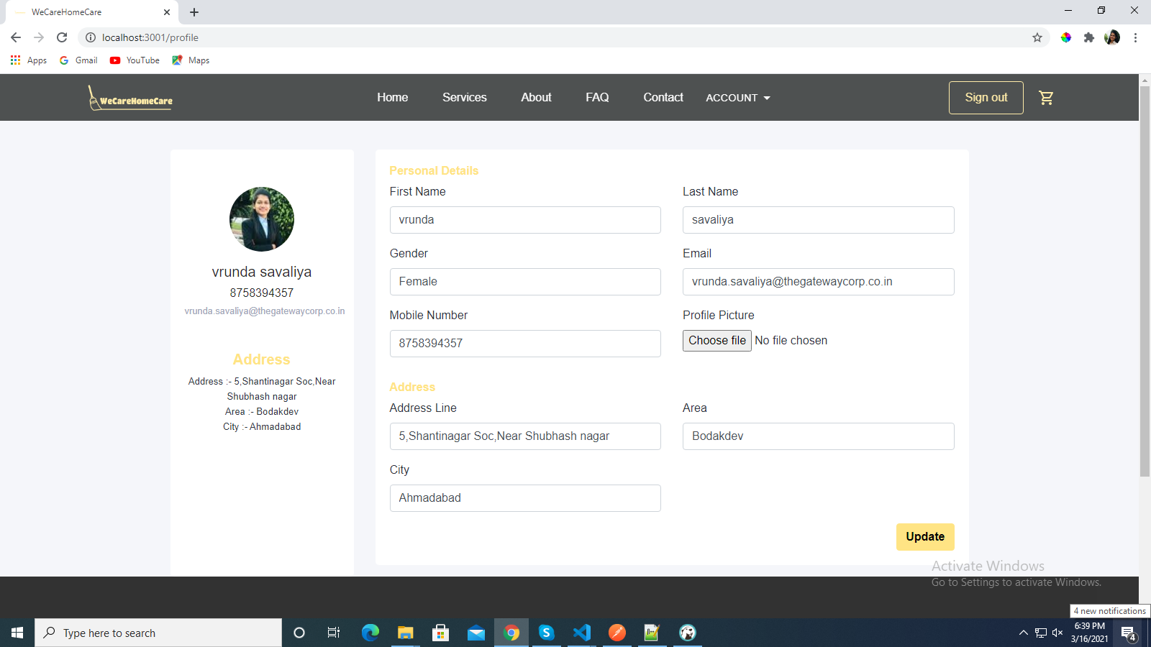
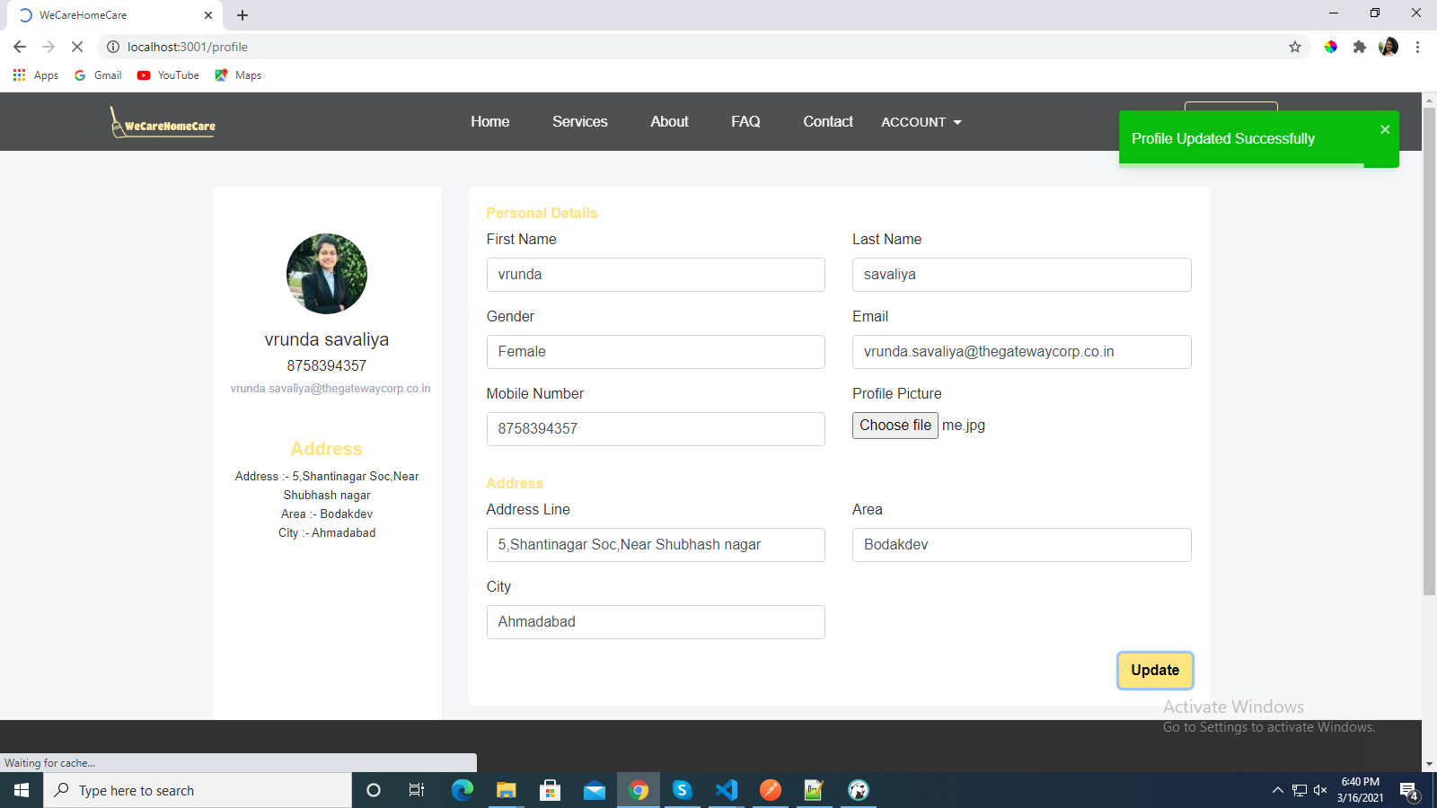
Profile
22

Slide 23
IMPLEMENTATION- ADMIN INTERFACE
23

Slide 24
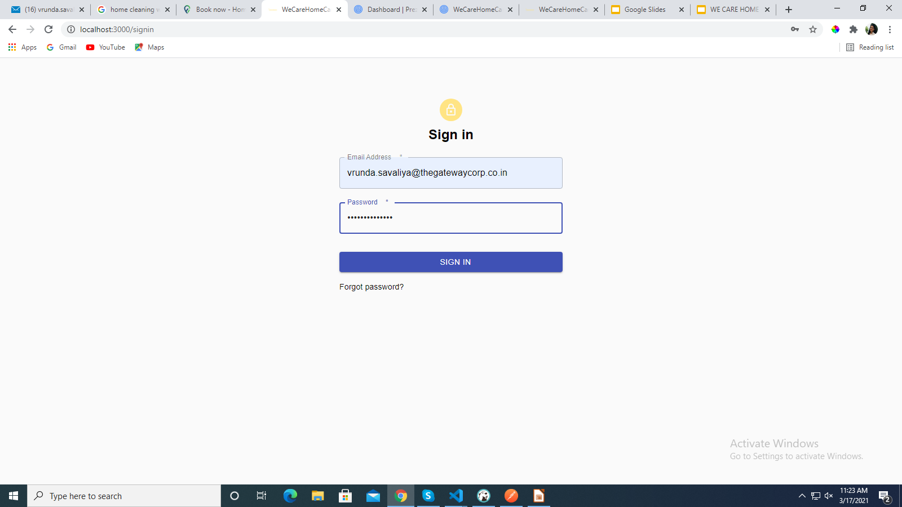
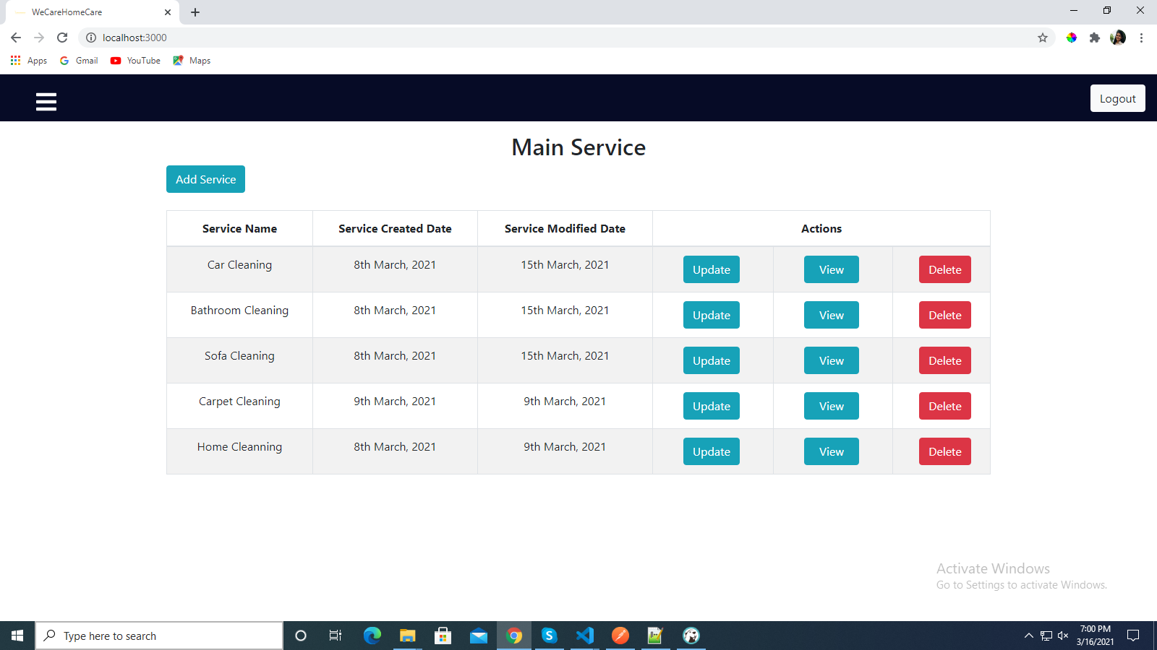
Manage Service
24

Slide 25
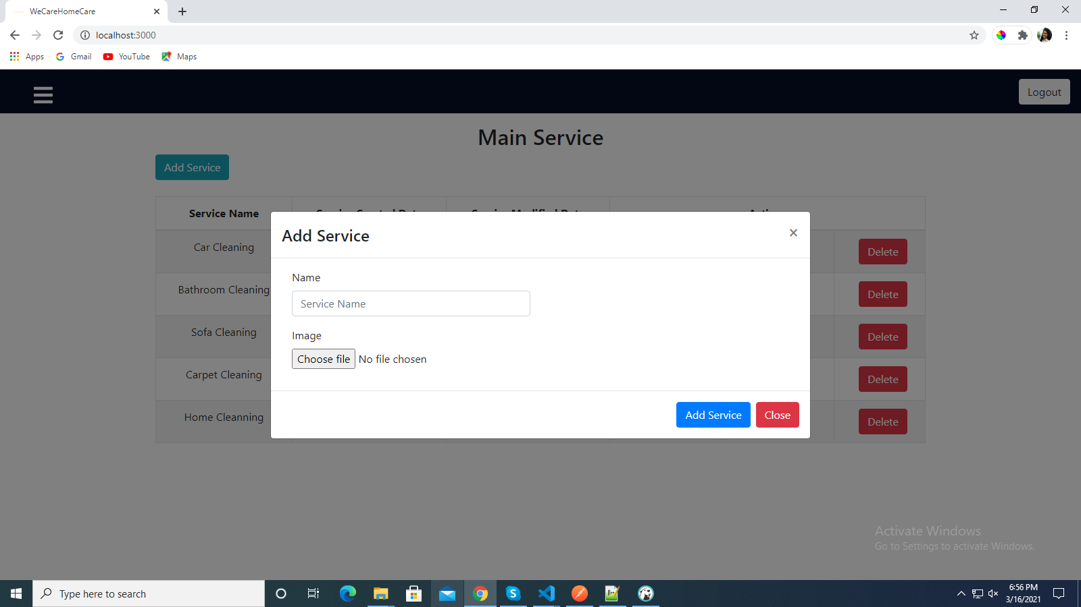
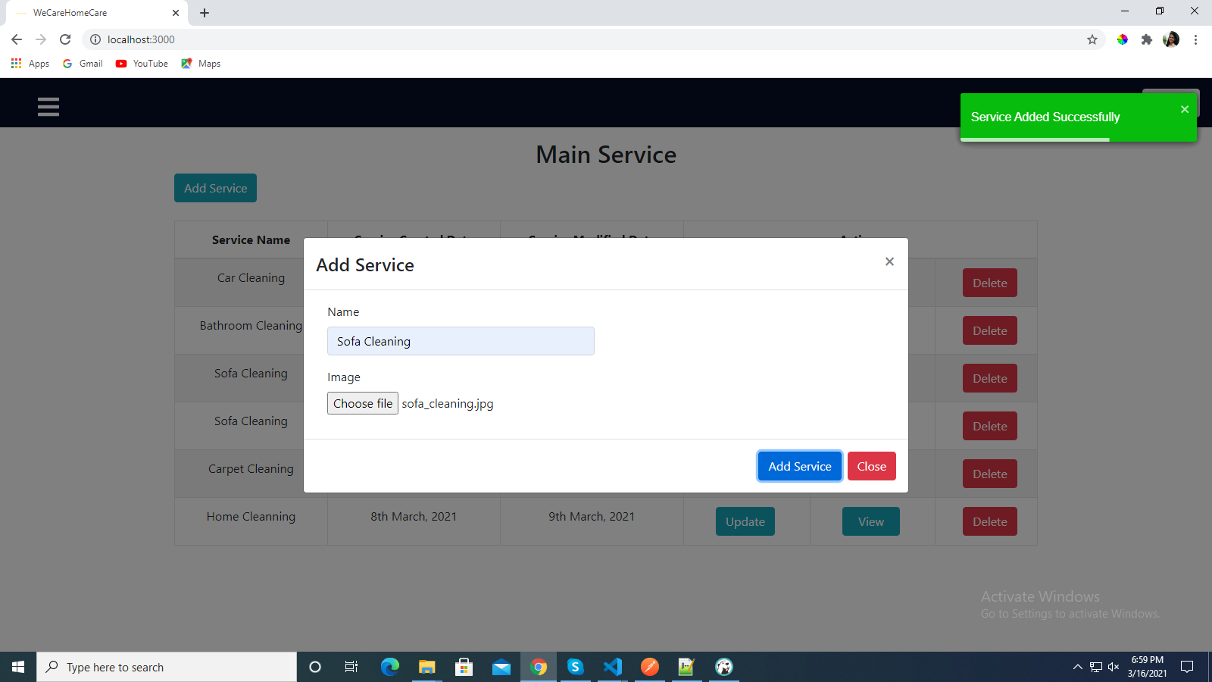
Add Service
25

Slide 26
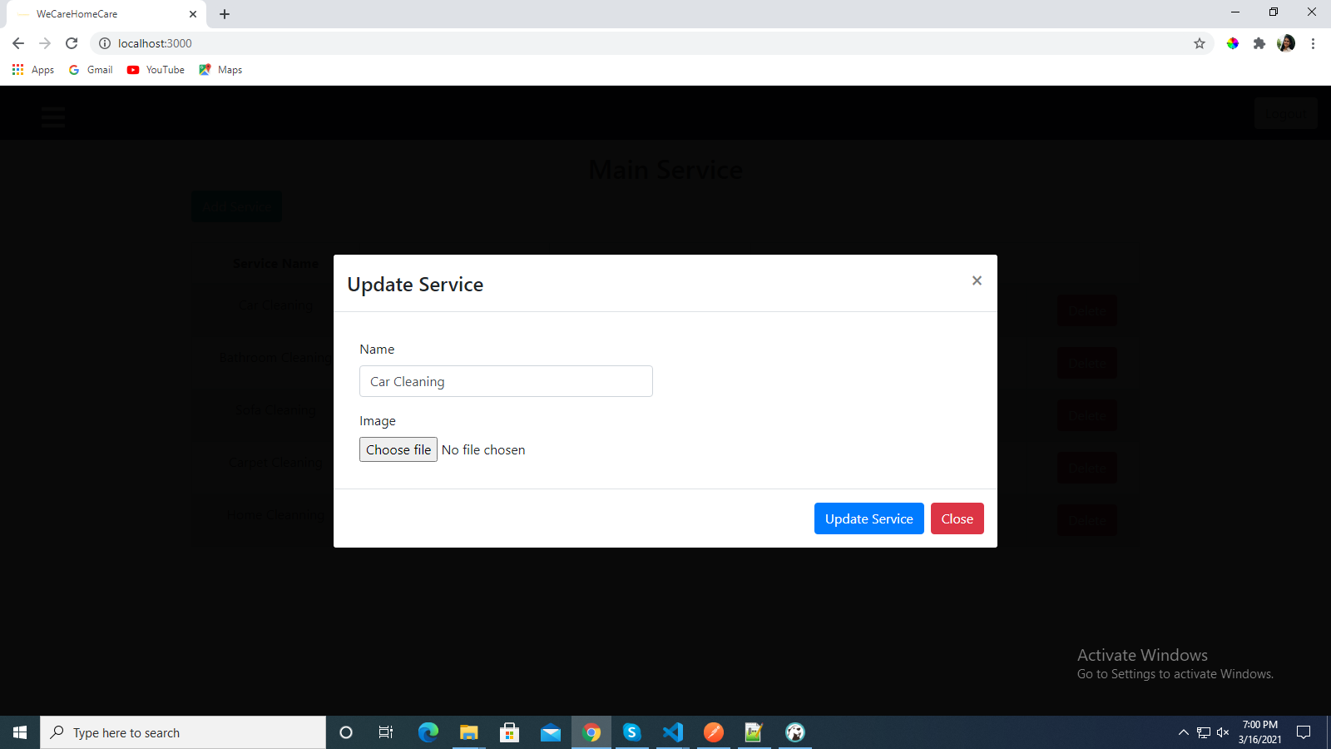
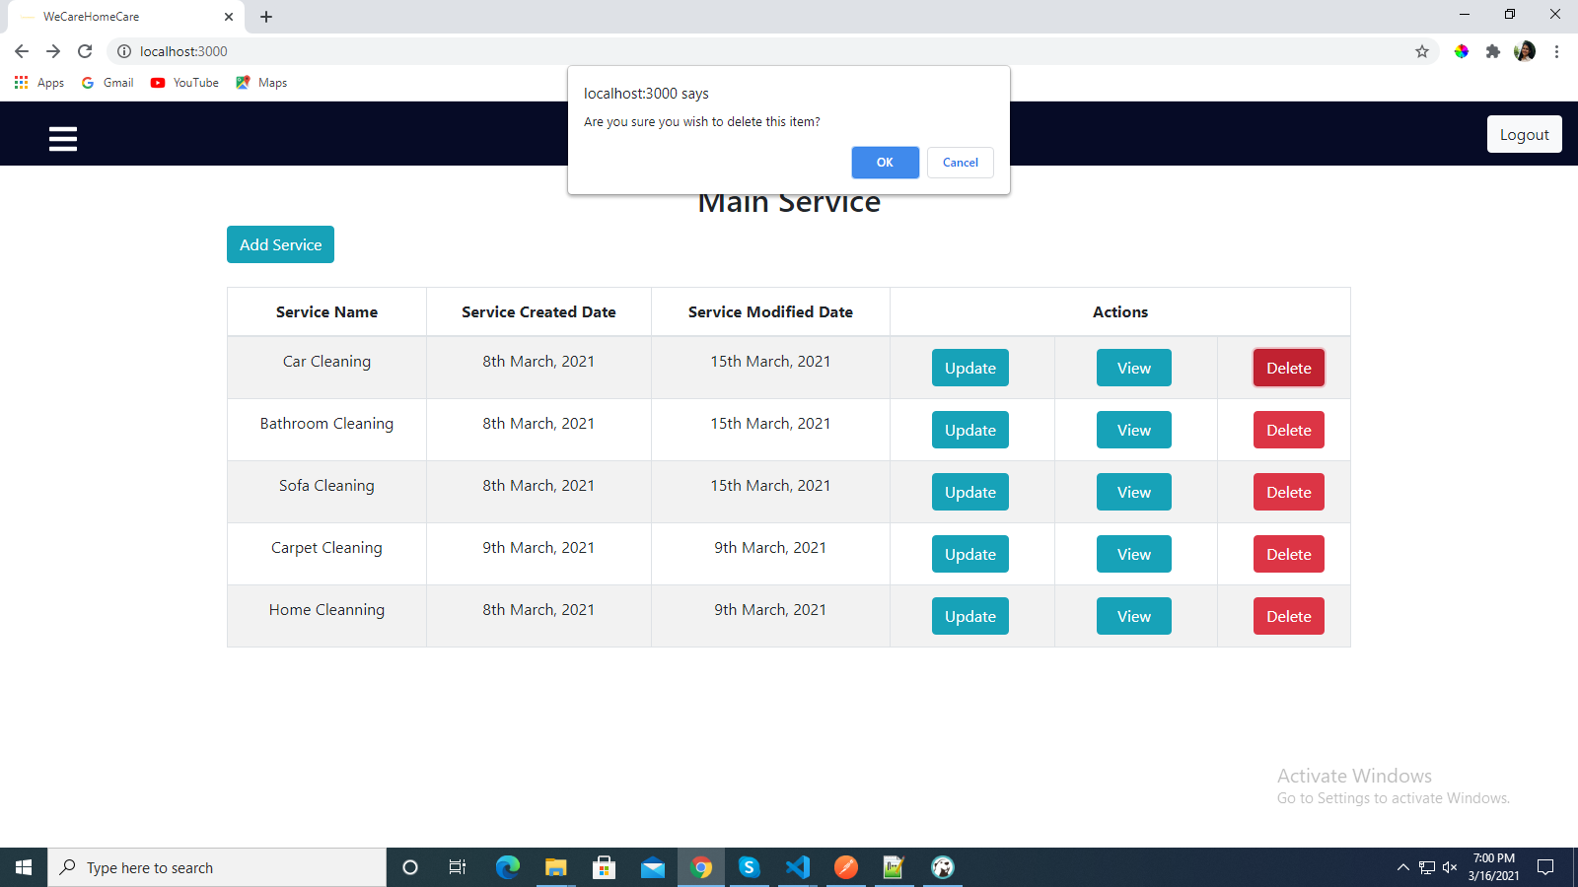
Update-Delete Service
26

Slide 27
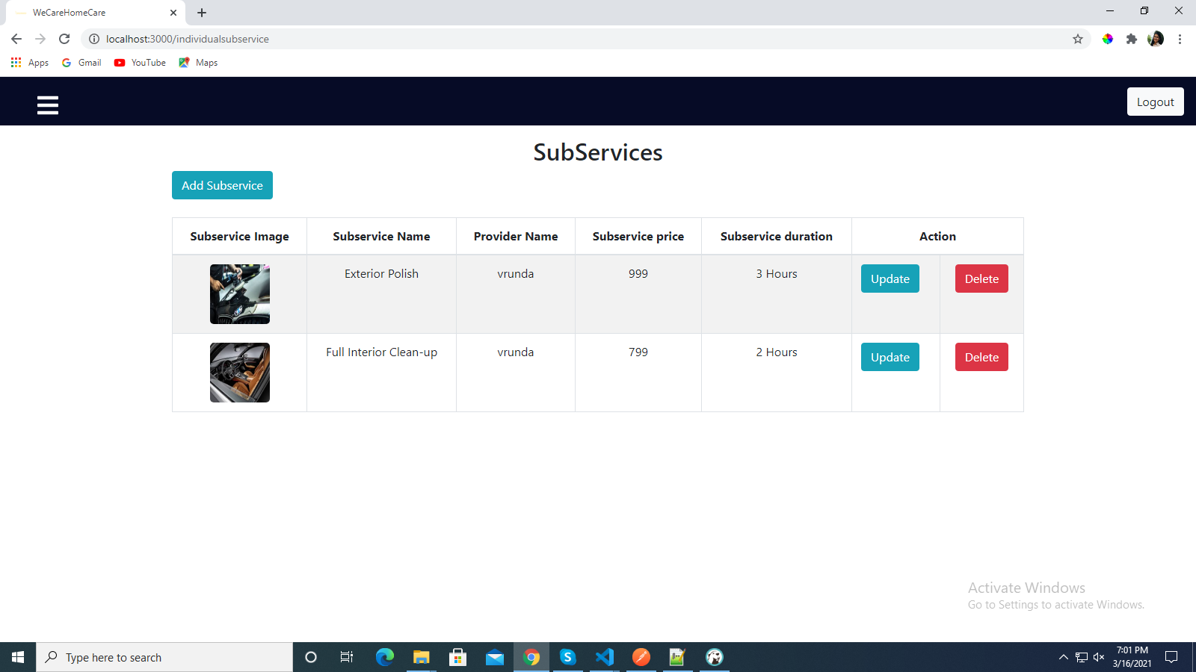
Manage Service Categories
27

Slide 28
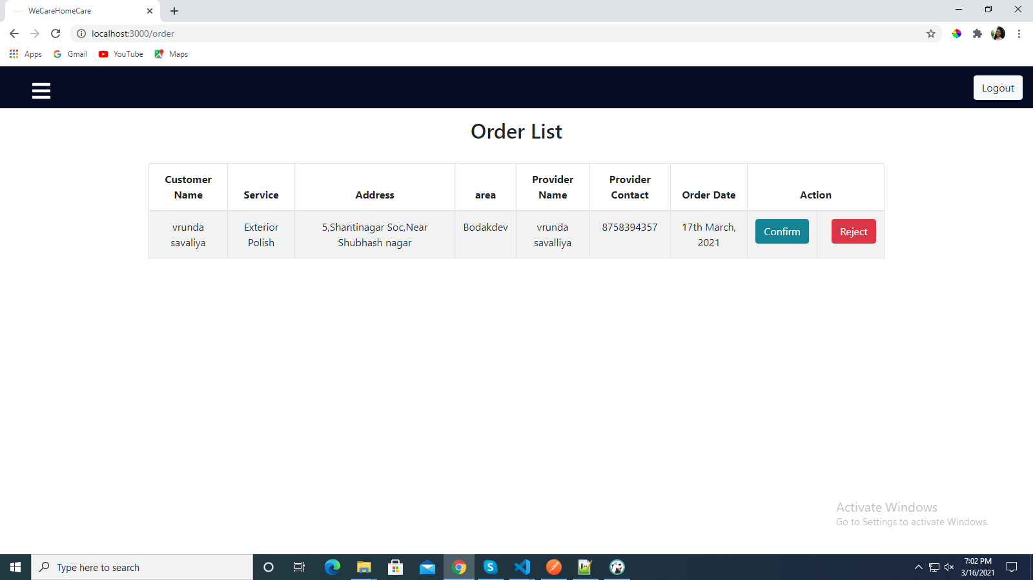
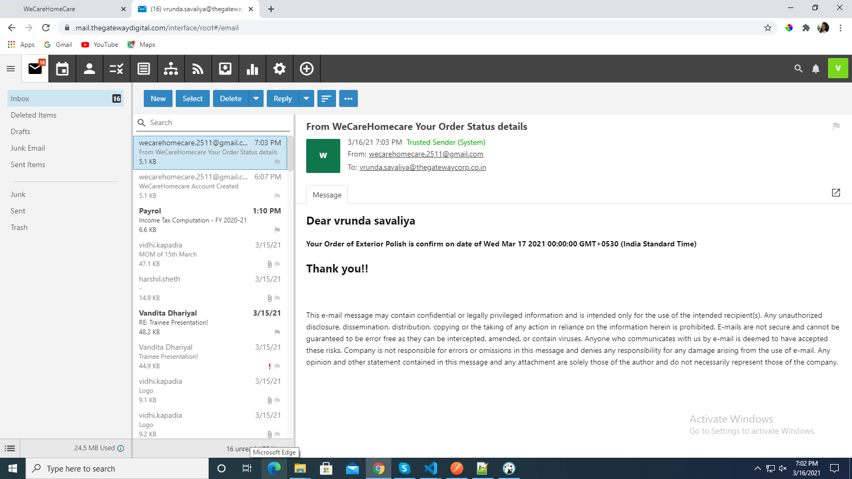
Manage Order
28

Slide 29
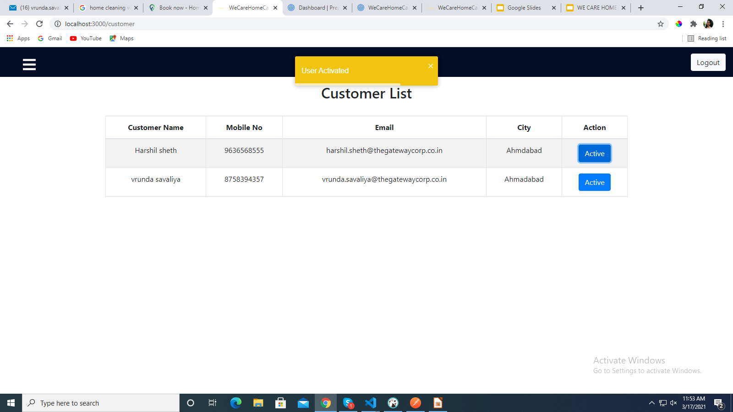
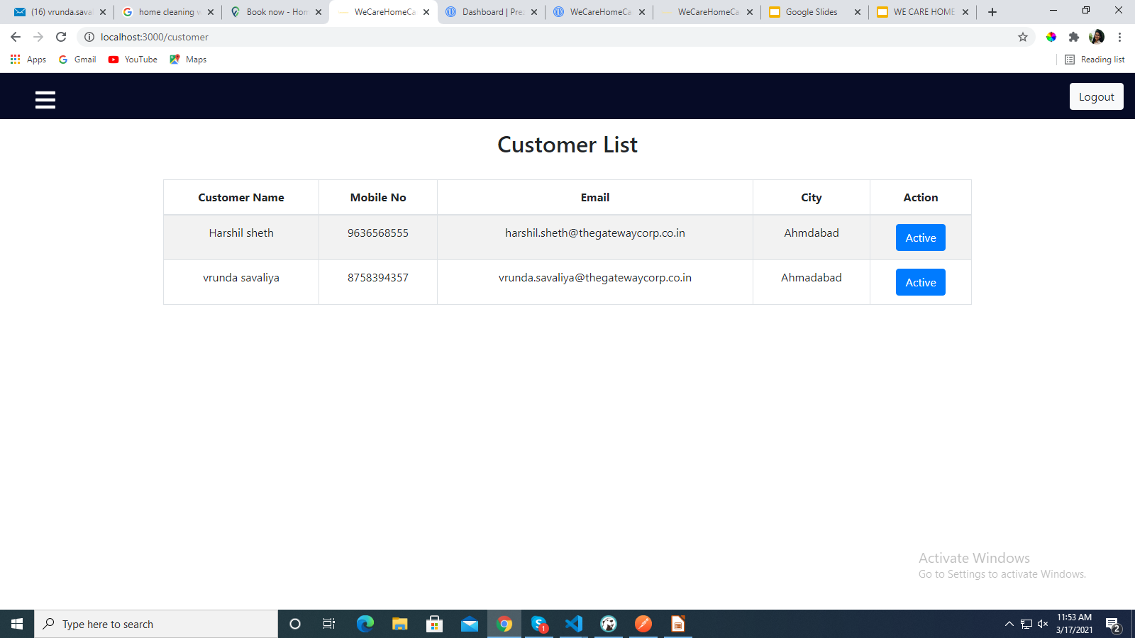
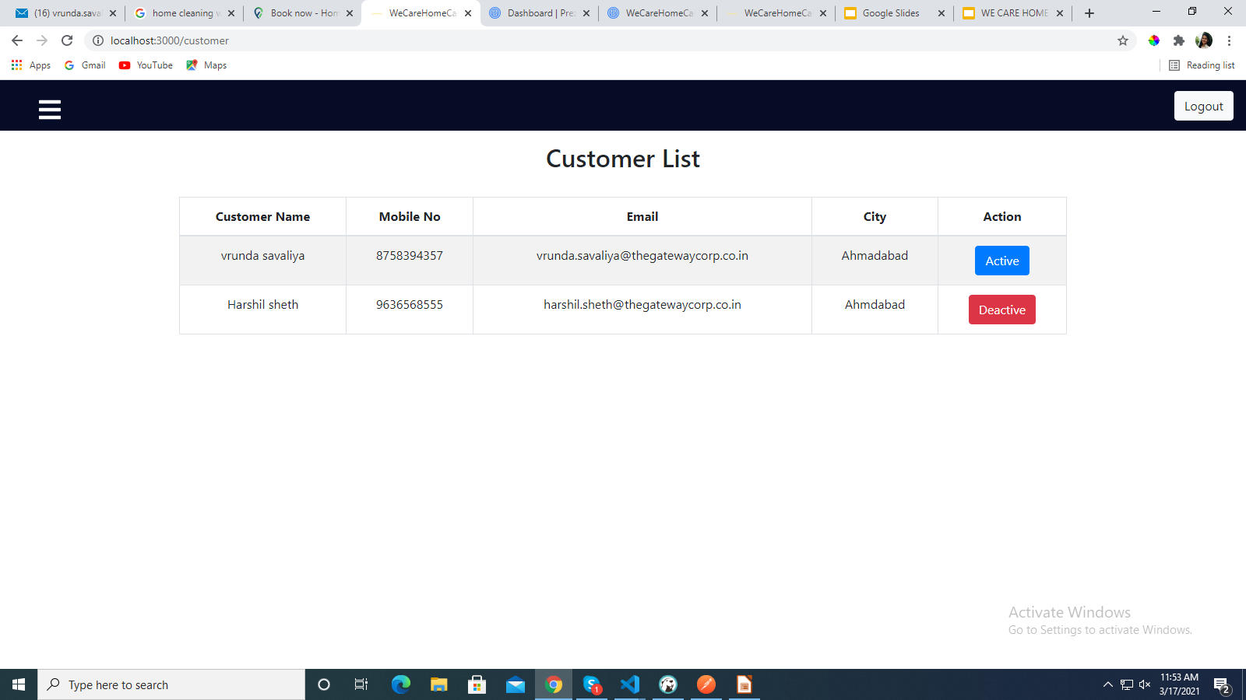
Manage Customer
29

Slide 30
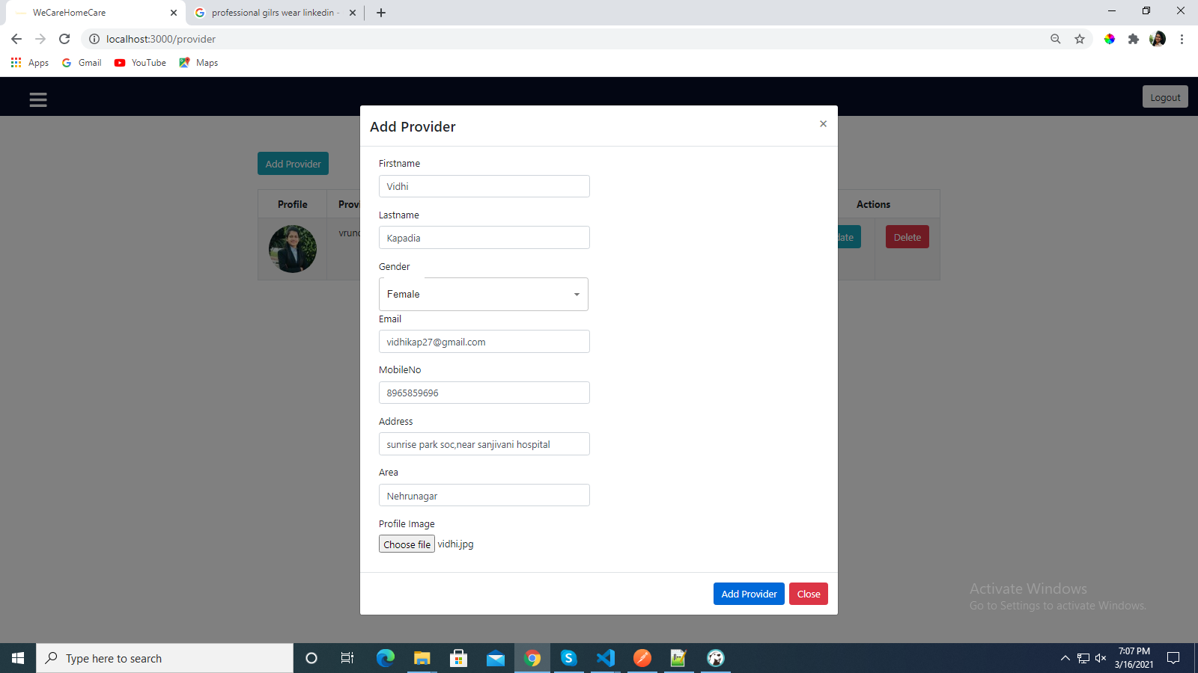
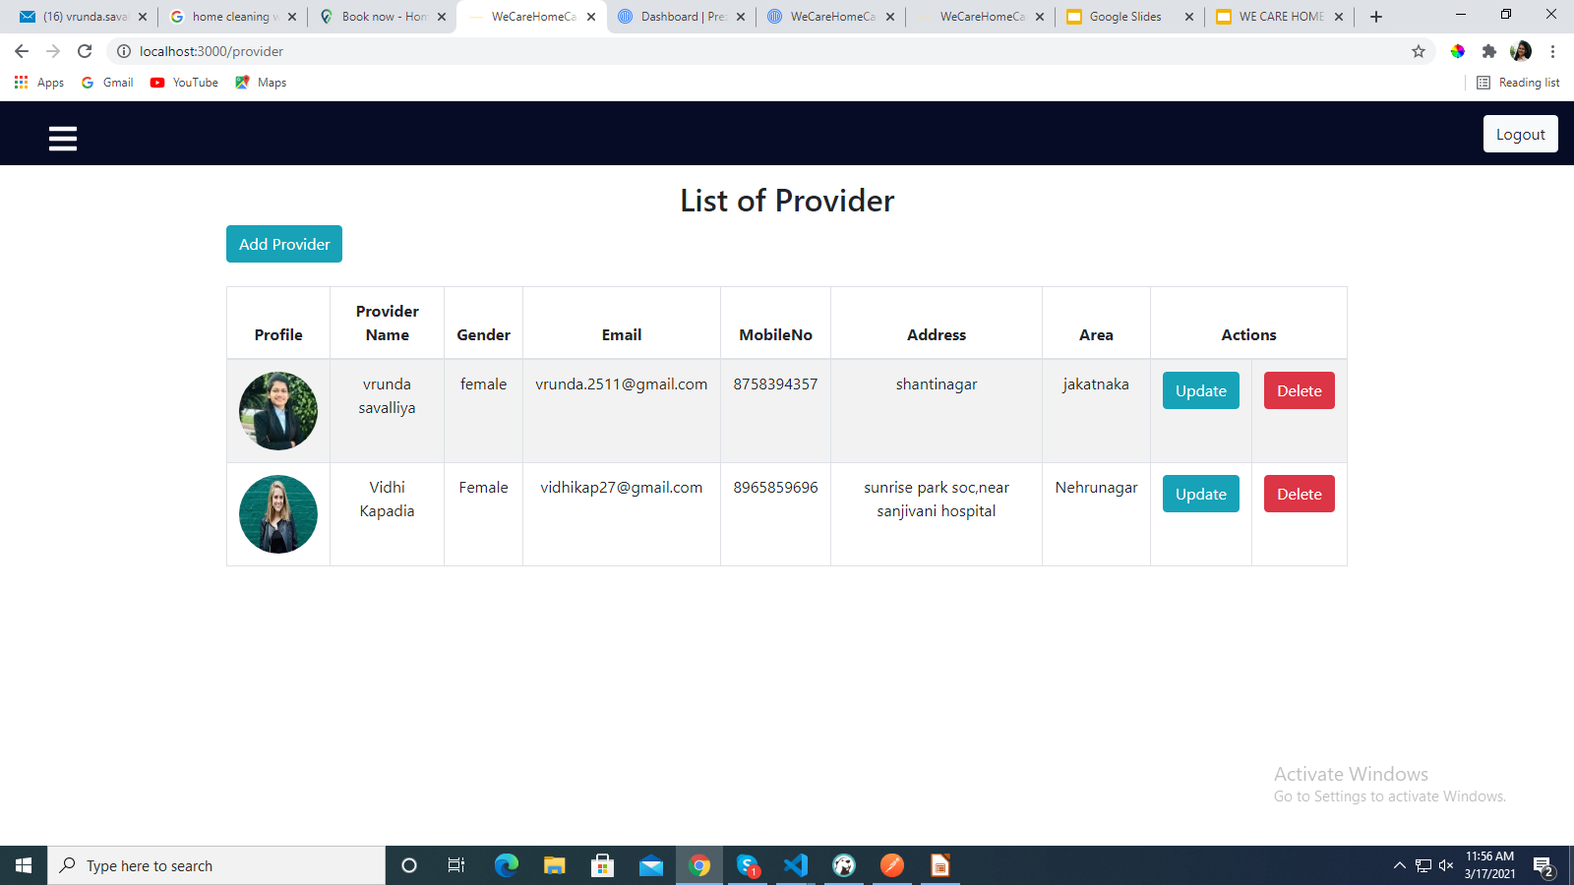
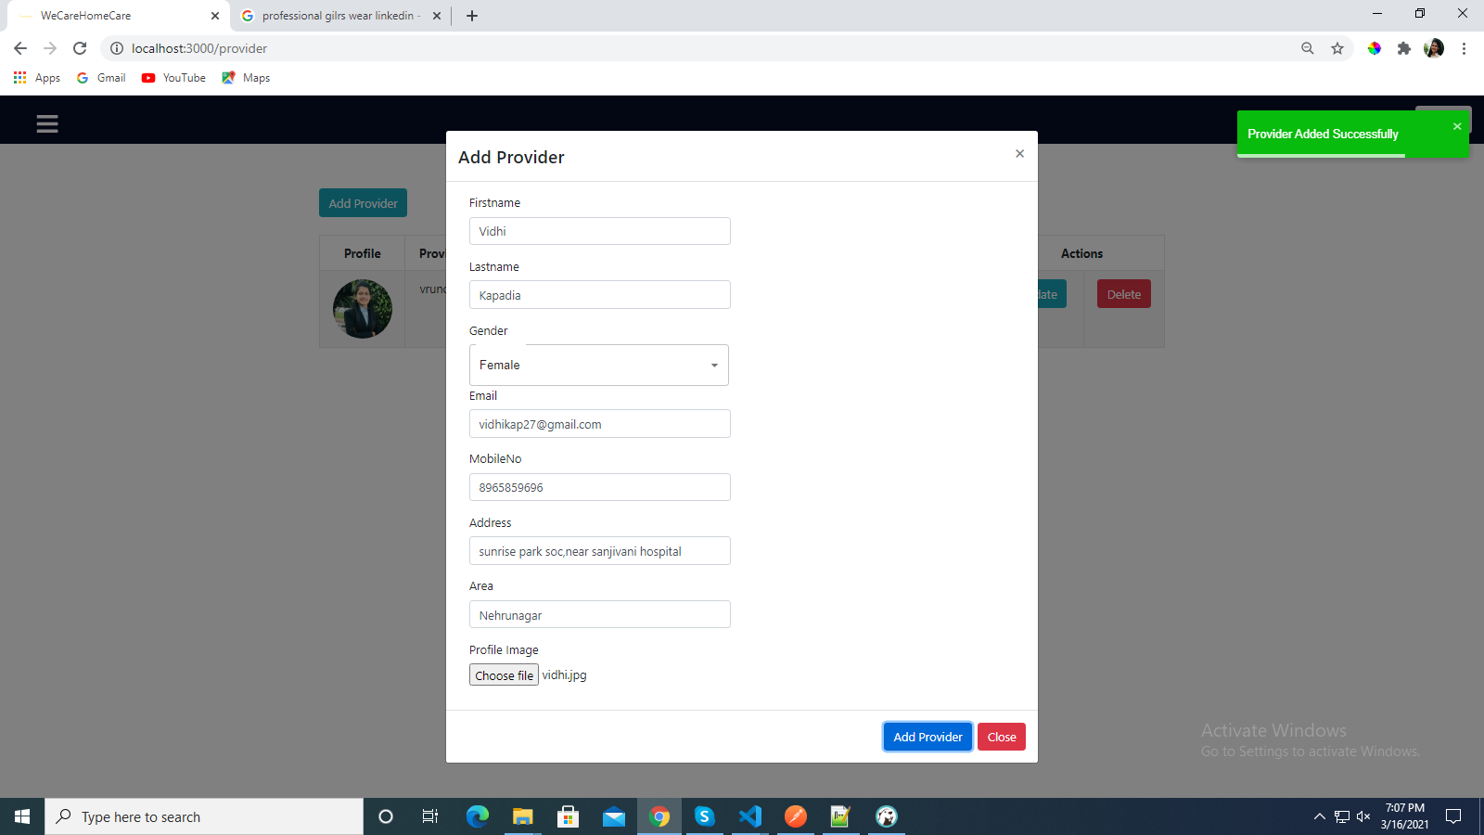
Manage Provider
30

Slide 31
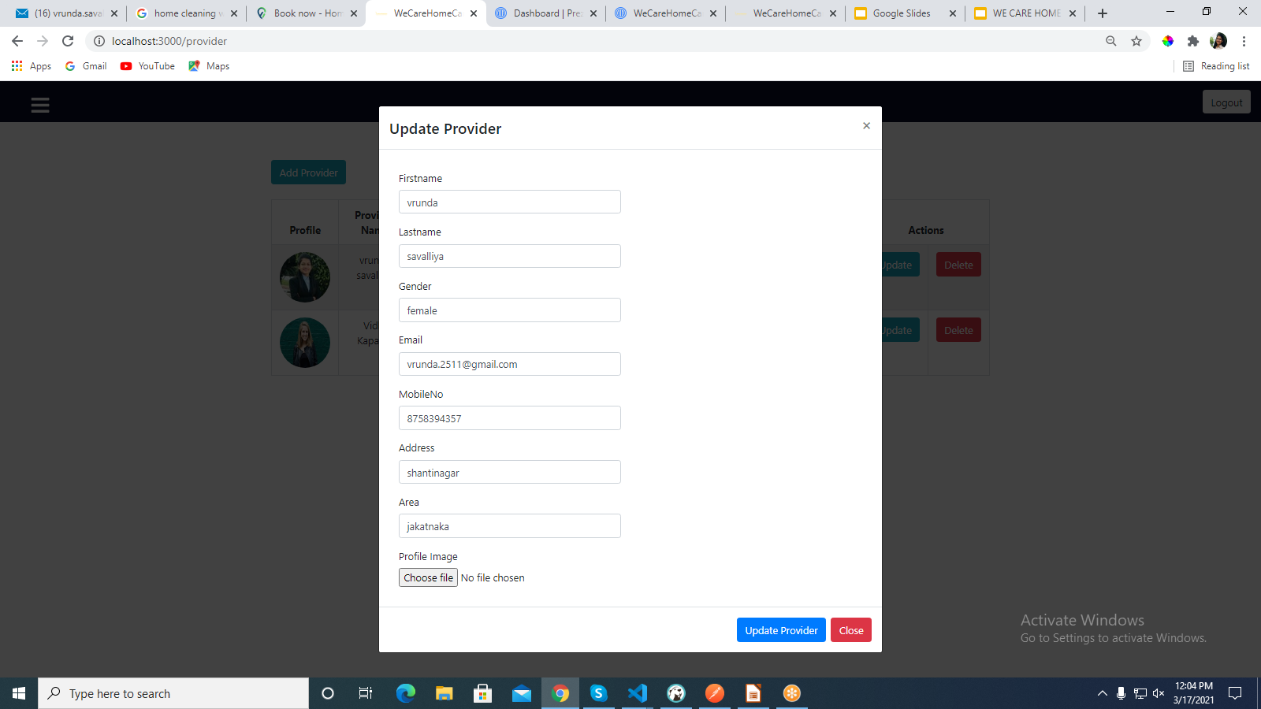
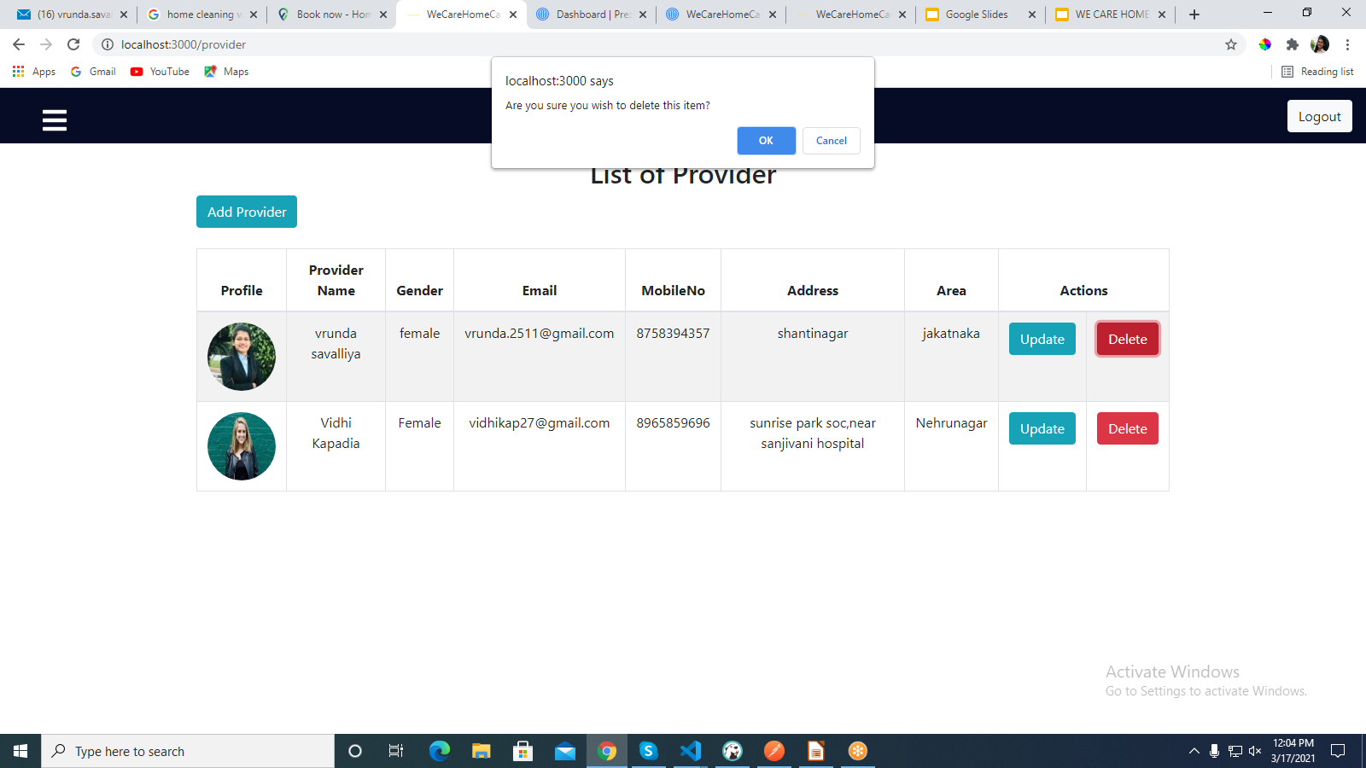
Update-Delete Provider
31

Slide 32
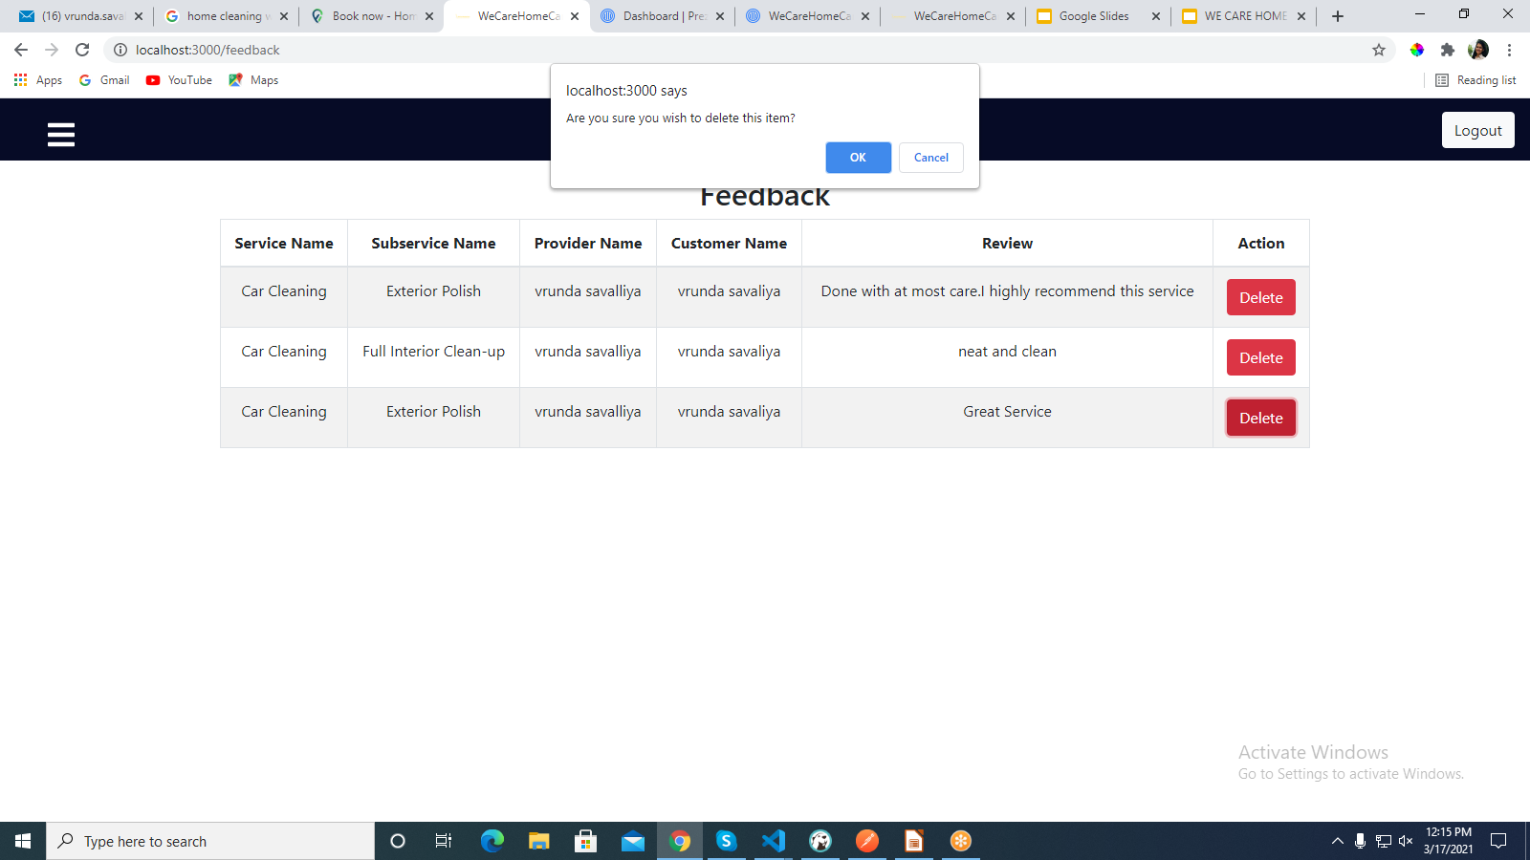
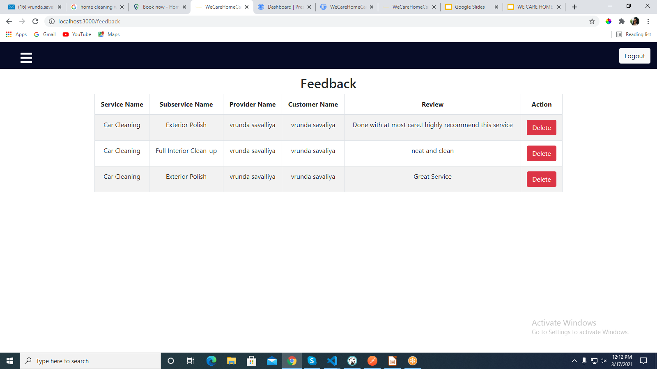
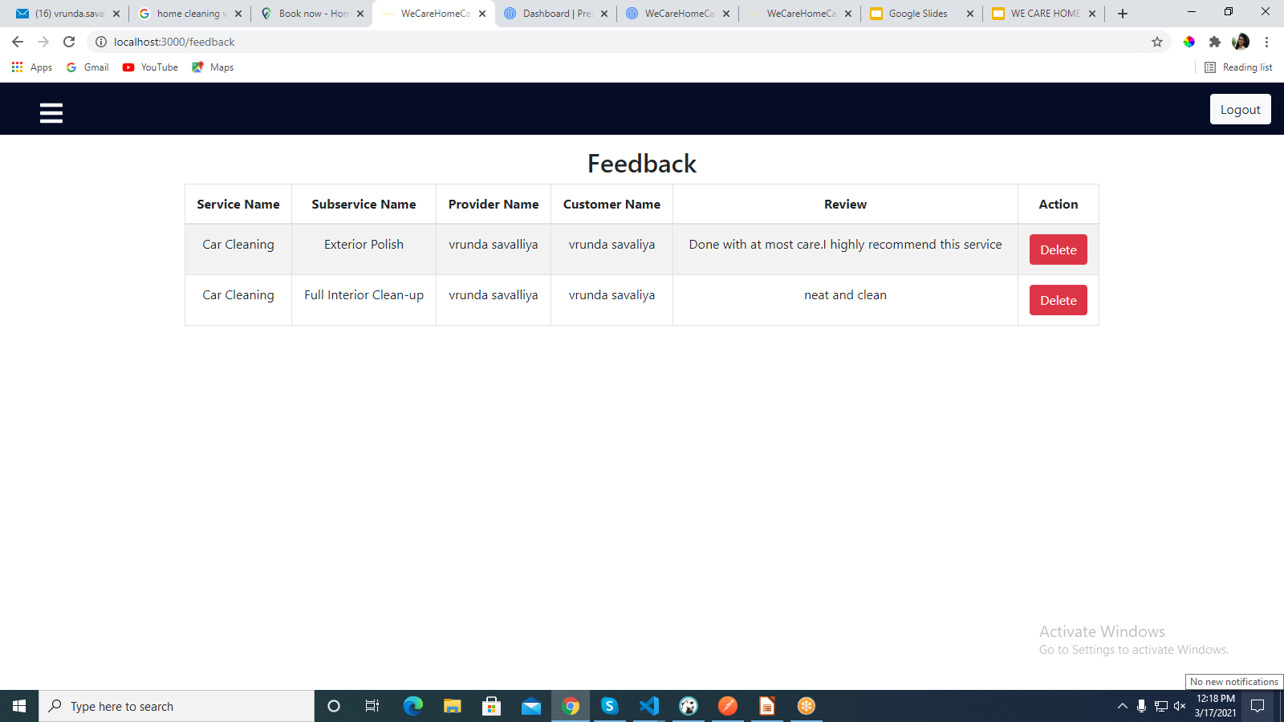
Manage Feedback
32

Slide 33
FUTURE ENHANCEMENT
In future, I will add Provider Dashboard in which they can able to add there services by their own.
Admin Dashboard
33

Slide 34
THANK YOU!!
<number>

